Slide 1

CPRG214
ASP.NET Core MVC

Slide 2
Internet Application Development 2
Resources
-- Class notes
-- Slides
-- BootStrap www.getbootstrap.com
Software
-- Visual Studio 2022 Preview Community Edition – Free download available at https://visualstudio.microsoft.com/vs/preview/#download-preview
-- .NET SDK (Software Development Kit)
-- Microsoft SQL Server 2022 Developer Edition – Free download available at https://www.microsoft.com/en-ca/sql-server/sql-server-downloads

Slide 3
Introduction to .NET
.NET formerly named .NET Core is a free and open-source, managed software framework for Windows, Linux and macOS operating system.
It is a cross-platform, unlike the old .NET framework that is only available in Windows operating system.
.NET (formerly .NET Core) is a redesigned version of the old .NET framework that is based on the simplified version of the class libraries.
ASP.NET Core 1.0 was released on June 27, 2016 along side with Microsoft Visual Studio 2015 update 3.0
On August 14, 2017, ASP.NET Core 2.0 was released along with Visual Studio 2017 15.3
ASP.NET Core 2.1 and Entity Framework Core 2.0 were released on May 30, 2018.

Slide 4
Introduction to .NET
ASP.NET Core 3 was released on September 23, 2019. This release added support for Windows Desktop application development. This release offered significant performance improvements throughout the base library.
The Core branding was removed with the release of .NET 5 in November 2020. Version 4 was skipped to avoid confusion with the classic .NET Framework which is at .NET 4. The .NET Framework still remains the Windows platform specific product.
In November 2021, .NET 6 was released and in November 2022 .NET 7 was released. It is projected that .NET 8 will be released in November 2023.

Slide 5
Introduction to .NET
Benefits of .NET (.NET Core)
Cross platform
.NET application can be developed and run across different platform like
Windows
macOS
Linux
.NET application can be hosted on
IIS
Apache
Docker
Self-hosted in your process

Slide 6
Introduction to .NET
Benefits of .NET (.NET Core)
.NET has built-in support for dependency injection
.NET is open source
Actively being developed by Microsoft team and vast community of open source developers
.NET comes with a rich set of built-in middleware components
Users can create their own custom middleware components

Slide 7
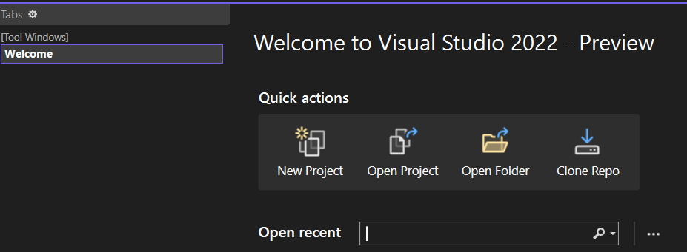
Introduction to .NET
Create a new .NET using the Empty Project template
To create a new .NET application, open Visual Studio 2022 and click on the Create a new project box as shown below
Click on New Project

Slide 8
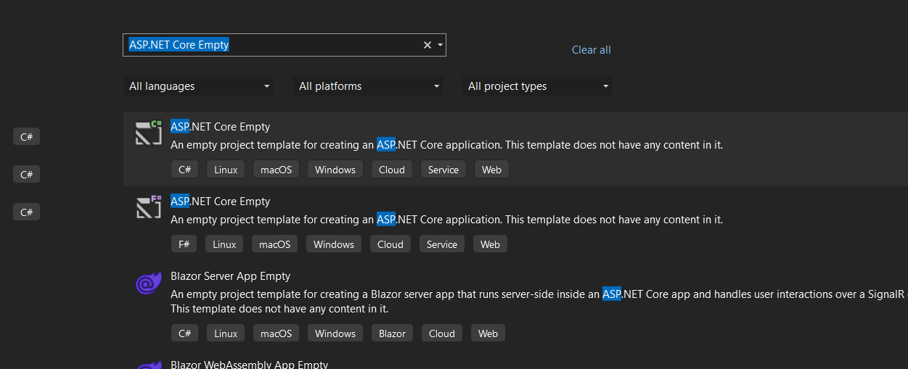
Introduction to .NET
Create a new .NET using the Empty Project template
Clicking on new project will open the screen below. Search for ASP.NET Core and select the ASP.NET Core Empty template for C#, then click the next button

Slide 9
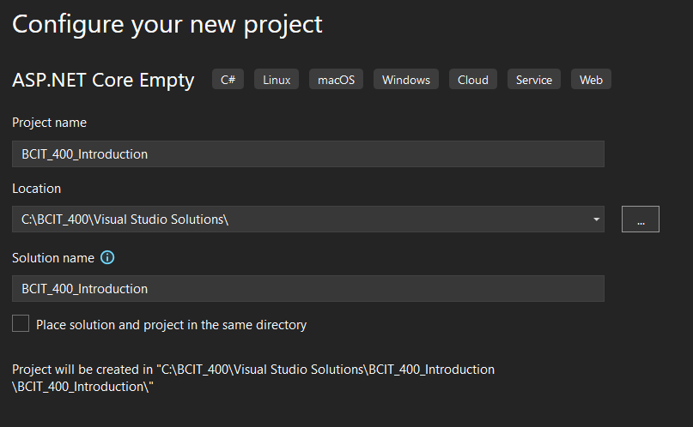
Introduction to .NET
Create a new .NET using the Empty Project template
This will open the next screen. Give the project a meaningful name in the Project name text box and the location in your computer to save the project, then click the next button

Slide 10
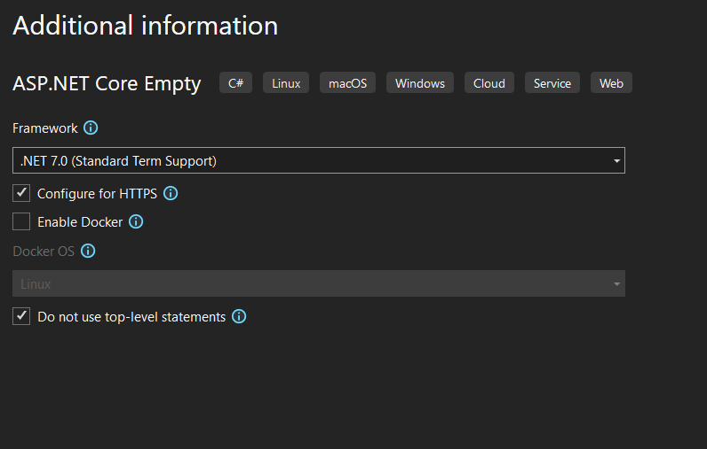
Introduction to .NET
Create a new .NET using the Empty Project template
On the next screen select the Framework. We will be using the .NET 7.0 Framework. Check the “Do not use top-level statements and Configure for HTTPs” checkboxes. The click on the create button.

Slide 11
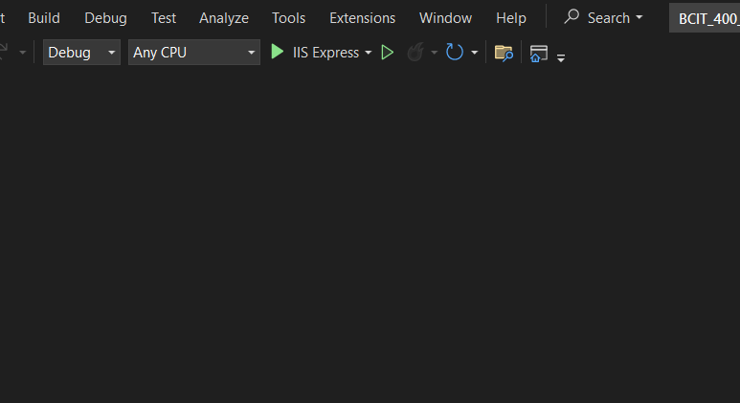
Introduction to .NET
Create a new .NET using the Empty Project template
Once the project is created, select IIS Express and run the project by clicking on the IIS Express or press F5 (with Debug) or Ctrl + F5 (without Debug)

Slide 12
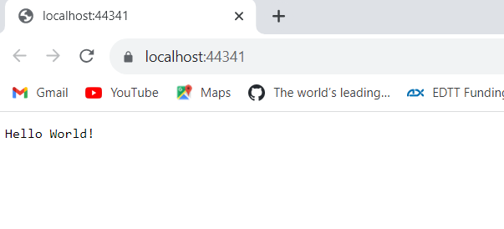
Introduction to .NET
Create a new .NET using the Empty Project template
This will open the browser and display the following output
The output “Hello World!” comes from the Main() method of the Program class, which is present inside the Program.cs file, as show in the image on the next slide.

Slide 13
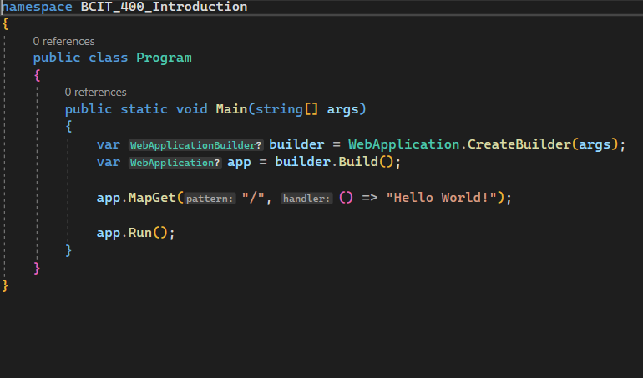
Introduction to .NET
Create a new .NET using the Empty Project template

Slide 14
Introduction to .NET
ASP.NET Core Project Templates
You must have noticed while you were creating the project, we have different types of project templates for creating ASP.NET Core Web application. Let us now explore what all these project templates and their use are
ASP.NET Core Empty: This Project template is used for creating ASP.NET Core Web Application, and this project template does not have any content in it by default.
ASP.NET Core Web App: This Project template is used for creating ASP.NET Core Application using ASP.NET Core Razor Pages content.
ASP.NET Core Web API: This Project template is used to create ASP.NET Core Application that uses Controllers to develop Restful services. This Project template can also be used for creating ASP.NET Core MVC Views and Controllers.
ASP.NET Core Web App (Model-View-Controller): This Project template is used for creating ASP.NET Core Applications using ASP.NET Core MVC Views and Controllers. This Project template can also be used for creating Restful HTTP Services.
Blazor Server App: This Project Template is used for creating a Blazor server app that runs server-side inside an ASP.NET Core app and handles user interactions over a SignalR connection. This template can also be used for web apps with rich, dynamic user interfaces (UIs).

Slide 15
Introduction to .NET
ASP.NET Core Project Templates
Blazor WebAssembly App: This Project template is used for creating Blazor App that runs on WebAssembly and is optionally hosted by an ASP.NET Core app. This template can also be used for web apps with rich, dynamic user interfaces (UIs).
Razor Class Library: This Project template is used for creating a Razor class library that targets .NET Standard.
ASP.NET Core with Angular: This Project template is used for creating ASP.NET Core Applications with Angular.
ASP.NET Core with React.js: This Project template is used for creating ASP.NET Core Applications with React.js.
NUnit Test Project: This Project template contains NUnit tests that can run on .NET on Windows, Linux, and MacOS.

Slide 16
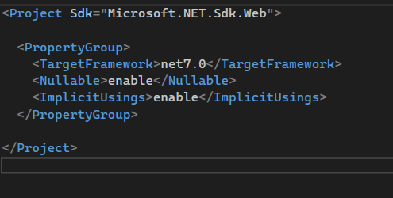
Introduction to .NET
ASP.NET Core Project Files
To edit the ASP.NET Core project file, right-click on the project name in the Solution Explorer and then select “Edit Project File” from the context menu. This will open the screen shown below
The project file is of type .csproj, cs in the type name means Csharp, because C# is the programming language.
TargetFramework: The TargetFramework element in the project file specifies the application’s target framework. To specify the target framework in the project file, the application uses something called Target Framework Moniker (TFM). In image above, the application targets the framework net7.0. The net7.0 is the Moniker for .NET 7. If you remember, we created this project with .NET Core 7.

Slide 17
Introduction to .NET
ASP.NET Core Project Files
Nullable: The nullable annotation and warning contexts can be set for a project using the <Nullable> element in your .csproj file. This element configures how the compiler interprets the nullability of types and what warnings are emitted. The value for this element is “enable” and “disable”.
ImplicitUsings: Implicit usings is a feature in .NET that allows the compiler to automatically add global usings to projects for common namespaces used in projects of the type developer have chosen. This can help developer get started more quickly in .NET by automatically importing common namespaces like System and System.Linq without them having to declare them somewhere in projects explicitly. The value for this element are enable and disable.
Implicit global using directives are added for projects that use one of the following SDKs
Microsoft.NET.Sdk – Console application
Microsoft.NET.Sdk.Web – Web application
Microsoft.NET.Sdk.Worker
Microsoft.NET.Sdk.WindowsDesktop – Desktop application

Slide 18
Introduction to .NET
ASP.NET Core Main() Method
The Main method of the Program class is the entry point of our ASP.NET Core Application.
where we configure the web host.
we also configure and register required services and configure middleware pipelines inside the Main method of the Program class.
as well as start the application to listen to the incoming HTTP Requests.

Slide 19
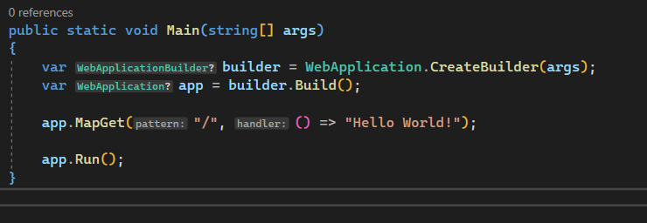
Introduction to .NET
ASP.NET Core Main() Method

Slide 20
Introduction to .NET
ASP.NET Core Main() Method
Create (Configure Web Server, Host, and Services)
var builder = WebApplication.CreateBuilder(args);
The code above is first line of the code in the Main() method. This code creates an instance of the WebApplicationBuilder sealed class. The CreateBuilder is a static method of WebApplication class that accepts the Command line arguments as an input parameter. This method initializes a new instance of the WebApplicationBuilder class with preconfigured defaults such as.
Set up Web Server
Host the Application
Logging
Configuration
Dependency Injection Container
Adds Framework Provided Services

Slide 21
Introduction to .NET
ASP.NET Core Main() Method
The CreateBuilder method creates, initializes, and returns a new instance of the WebApplicationBuilder class. The WebApplicationBuilder instance is used to configure and register additional services. The WebApplicationBuilder exposes the following.
IWebHostEnvironment: It provides information about an application’s web hosting environment. It will provide information on whether the application is hosted using In-Process or OutOfProcess Hosting Model. Whether it is using IIS Server or Kestrel Web Server, or both.
IServiceCollection: A collection of services that can be used throughout an application. This is useful for adding user-provided or framework-provided services. It provides methods to register different types of services, such as Transient, Scoped, and Singleton services.
ConfigurationManager: A collection of configuration providers that can be used throughout an application. This is useful for adding new configuration sources and providers.
ILoggingBuilder: A collection of logging providers that can be used throughout an application. This is useful for adding new logging providers.
As we progress through this course, we will configure different types of in-built services and discuss custom services and how to configure them.

Slide 22
Introduction to .NET
ASP.NET Core Main() Method
var app = builder.Build();
The Build method of the WebApplicationBuilder class creates a new instance of the WebApplication class.
The Web Application instance is used to set up the Middlewares and endpoints for an ASP.NET Core Application.
The empty template has set one middleware component using the MapGet extension method as follows:
app.MapGet("/", () => "Hello World!");
app.Run();
The Run() method of the WebApplication instance starts the application and listens to HTTP requests.

Slide 23
Introduction to .NET
MapGet() Method in ASP.NET Core Empty Project template
Routing in ASP.NET Core is responsible for matching incoming HTTP requests (URLs) and navigating these HTTP requests to the application’s executable endpoints which will handle the request.
Endpoint is an application’s executable code that will execute for handling the request.
The Empty project templates configures a single endpoint using the MapGet() method.
When an HTTP GET request is sent to the application’s root URL “/”
The request delegates executes () => "Hello World!“
Hello World! Is written to the HTTP response.

Slide 24
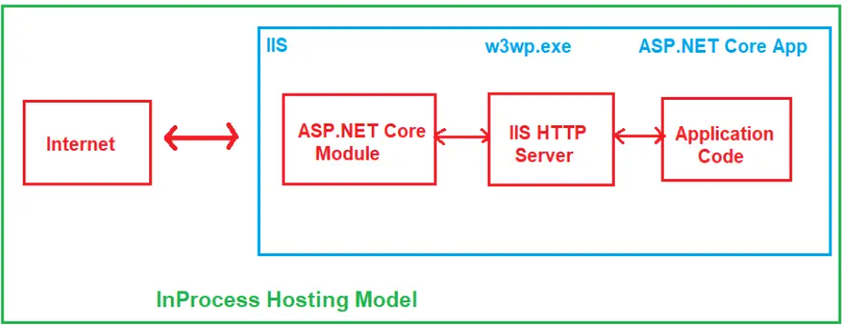
Introduction to .NET
ASP.NET Core Hosting Model
In ASP.NET Core, there are two types of Hosting Models:
InProcess and
OutOfProcess.
InProcess Host Model
In this hosting model; the ASP.NET Core Web Application is hosted inside the IIS Worker Process.
w3wp.exe and IIS is the only Web Server that handles the incoming HTTP Request.

Slide 25
Introduction to .NET
ASP.NET Core Hosting Model
InProcess Host Model
For the InProcess hosting model, a request from a user to IIS on the website’s configured port through the internet over HTTP or HTTPS protocol. Usually 80 (HTTP) or 443 (HTTPS).
The ASP.NET Core Module receives the native request and passes it to IIS HTTP Server (IISHttpServer). IIS HTTP Server is nothing but the In-Process Server implementation for IIS.
After the IIS HTTP Server Processes the Request, the request is sent to the ASP.NET Core Application Request Processing (Middleware) Pipeline.
The Middleware Pipeline handles the request and passes it on as an HttpContext instance to the application logic. The application logic will get all the requested information from the HttpContext instance and start executing the application logic.
Once the Middleware Pipeline handles the request, it will generate the response, which is sent back to IIS through IIS HTTP Server.
And finally, IIS sends the response back to the user who initiated the request.

Slide 26
Introduction to .NET
ASP.NET Core Hosting Model
InProcess Host Model
The ASP.NET Core Module (ANCM) is a native IIS module that plugs into the IIS Request Processing Pipeline, allowing ASP.NET Core Applications to work with IIS. The ASP.NET Core Module (ANCM) allows running ASP.NET Core Applications with IIS by either:
Hosting an ASP.NET Core Application inside of the IIS worker process (w3wp.exe), is called the in-process hosting model.
Forwarding web requests to a backend web server called Kestrel server which runs the ASP.NET Core Application, is called the out-of-process hosting model. We will discussed out-of-process hosting in details.
IIS HTTP Server
Internet Information Services, also known as IIS, is a Microsoft web server that runs on the Windows operating system and is used to exchange static and dynamic web content with internet users. IIS can be used to host, deploy, and manage web applications using technologies such as ASP.NET and ASP.NET Core.

Slide 27
Introduction to .NET
ASP.NET Core Hosting Model
Configure InProcess Hosting in ASP.NET Core
When a new ASP.NET Core Web Application is created by using any Project Template, by default, the project file is created with InProcess Hosting, which is used for hosting the application in IIS or IIS Express because it gives better performance than OutOfProcess hosting model.
Only one web server; IIS Server is used for the InProcess Hosting.
To Manually configure the InProcess Hosting for the ASP.NET Core Web application, add the <AspNetCoreHostingModel> element to the application project file with a value of InProcess. To do so, right-click on the project from the solution explorer and then click on the “Edit Project File” option from the context menu.
Once the Application Project file is opened, then the file is modified as shown on the next slide below. Here the <AspNetCoreHostingModel> element is added and set its value to InProcess. The other possible value for this element is OutOfProcess.

Slide 28
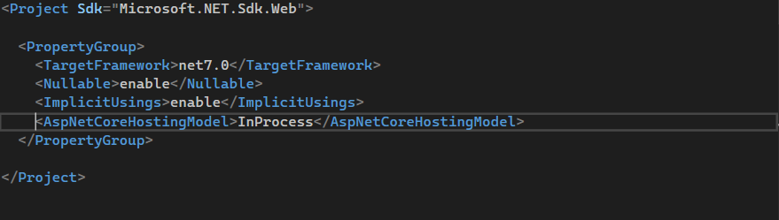
Introduction to .NET
ASP.NET Core Hosting Model
Configure InProcess Hosting in ASP.NET Core
Another way to specify the Hosting Model as InProcess is to use the GUI. To specify this, right-click on the project in the solution explorer and click on the Properties option from the context menu, which will open the Project Properties window. Select the Debug tab from this window and click on the Open debug launch profiles UI button.

Slide 29
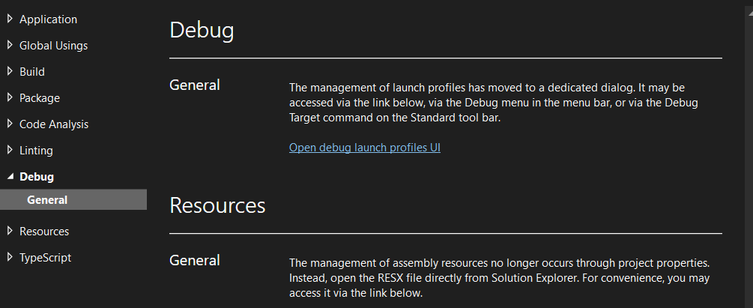
Introduction to .NET
ASP.NET Core Hosting Model
Configure InProcess Hosting in ASP.NET Core
Once the Open debug launch profiles UI button is clicked, it will open the Launch Profile window. From this window, select IIS Express and scroll down; somewhere, you will find the Hosting Model drop-down list with values for selection. The InProcess Hosting Model is selected as the default hosting model. Whatever hosting model that is desired can be selected here.

Slide 30
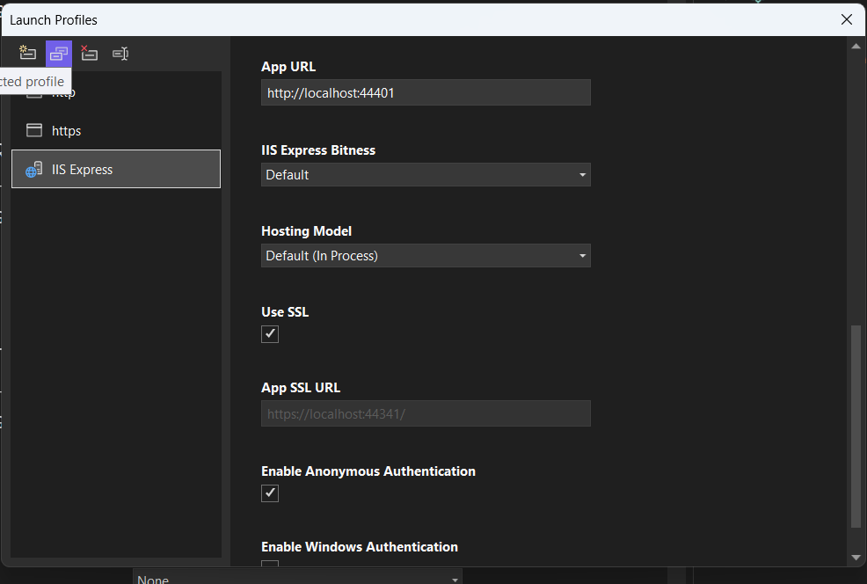
Introduction to .NET
ASP.NET Core Hosting Model
Configure InProcess Hosting in ASP.NET Core

Slide 31
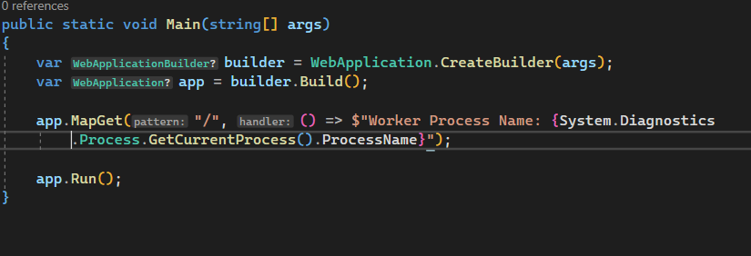
Introduction to .NET
ASP.NET Core Hosting Model
Configure InProcess Hosting in ASP.NET Core
To use the InProcess hosting model in Visual Studio, first, set the launch profile as IIS Express.
To display the process name in the browser, we need to modify the Main() method of the Program class as show below.
When the application is run from Visual Studio, the browser will display the message as show on the next slide.

Slide 32
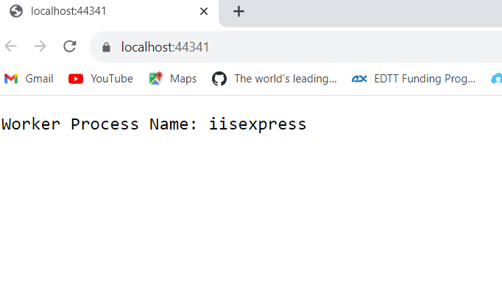
Introduction to .NET
ASP.NET Core Hosting Model
Configure InProcess Hosting in ASP.NET Core
By default Visual Studio uses IISExpress to run an application.

Slide 33
Introduction to .NET
ASP.NET Core Hosting Model
What is IIS Express?
The IIS Express is a lightweight, self-contained version of the IIS. It is optimized for Web Application Development. IIS Express is only used in development, not production. In production, we generally use IIS. We will discuss how to deploy an ASP.NET Core Application on IIS as we progress through this course.

Slide 34
Introduction to .NET
ASP.NET Core Hosting Model
OutOfProcess Hosting Model
The are 2 servers in the ASP.NET Core OutOfProcess Hosting Model
An Internal Web Server, which is the Kestrel Web Server
And an External Web Server can be IIS, Apache, or Nginx.
Depending on how the application is ran with the OutOfProcess hosting model, the external web server (i.e., IIS, Apache, and Nginx) may or may not be used.
The Kestrel web server is a cross-platform web server already embedded in an ASP.NET Core application.
Kestrel as Internet-Facing Web Server (Edge Server) or External Web Server
Kestrel as the Internal Web Server

Slide 35
Introduction to .NET
ASP.NET Core Hosting Model
OutOfProcess Hosting Model
Kestrel as Internet-Facing Web Server (Edge Server) or External Web Server
In this scenario, only the Kestrel Server is used to directly process the incoming HTTP requests, and the other one, i.e., external web server (i.e., IIS, Apache, and Nginx), is not going to be used. So, when the application is ran using the .NET core CLI, Kestrel is the only Web Server that will be used to handle and process the incoming HTTP request, as shown in image on the next slide.

Slide 36
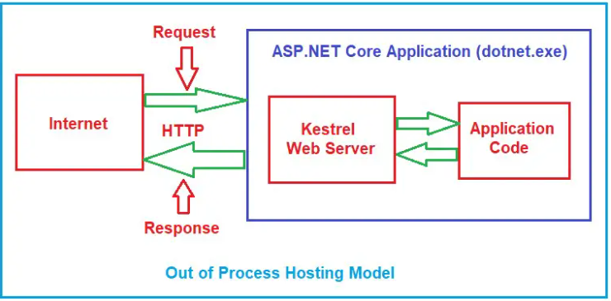
Introduction to .NET
ASP.NET Core Hosting Model
OutOfProcess Hosting Model
Kestrel as Internet-Facing Web Server (Edge Server) or External Web Server
Running the application using the .NET Core CLI, Kestrel is the only Web Server that will be used to handle and process the incoming HTTP request as show in the diagram above. And the Worker Process Name will display as the name of the project.

Slide 37
Introduction to .NET
ASP.NET Core Hosting Model
OutOfProcess Hosting Model
Kestrel as the Internal Web Server
The Kestrel can be used as the Internal Web Server.
In this scenario, the Kestrel Web Server can be used along with a Reverse Proxy Server such as IIS, Apache, or Nginx.
Reverse Proxy Server provides an additional layer of configuration and security which is not available with the Kestrel Server.
It is also good for load balancing.
When Kestrel Web Server is used along with a Reverse Proxy Server.
The Reverse Proxy Server will receive the incoming HTTP requests from the client and then forward that request to the Kestrel Web Server for processing.
Once the Kestrel Server receives the request, it will process the request, generate the response, and send the response back to the Reverse Proxy Server, which then sends the response back to the requested client over the Internet who initially made the request. See the diagram on the next slide.

Slide 38
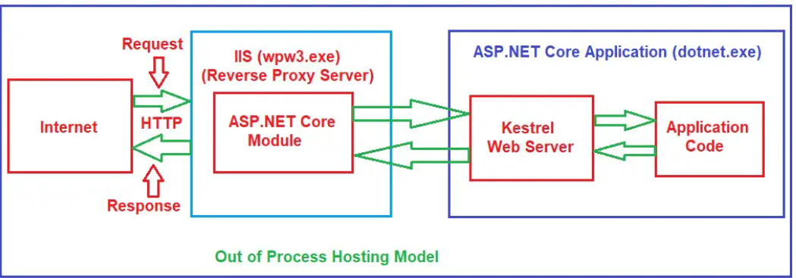
Introduction to .NET
ASP.NET Core Hosting Model
OutOfProcess Hosting Model
Kestrel as the Internal Web Server

Slide 39
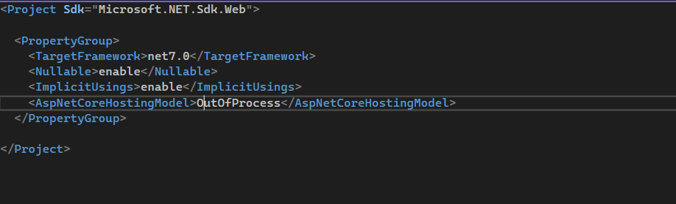
Introduction to .NET
ASP.NET Core Hosting Model
Configure OutOfProcess Hosting in ASP.NET Core
Another way to specify the Hosting Model as OutOfProcess is to use the GUI. To specify this, right-click on the project in the solution explorer and click on the Properties option from the context menu, which will open the Project Properties window. Select the Debug tab from this window and click on the Open debug launch profiles UI button.

Slide 40
Introduction to .NET
ASP.NET Core Hosting Model
Configure OutOfProcess Hosting in ASP.NET Core
Once the Open debug launch profiles UI button is clicked, it will open the Launch Profile window. From this window, select IIS Express and scroll down; somewhere, you will find the Hosting Model drop-down list with the following values. Select the Out Of Process.

Slide 41
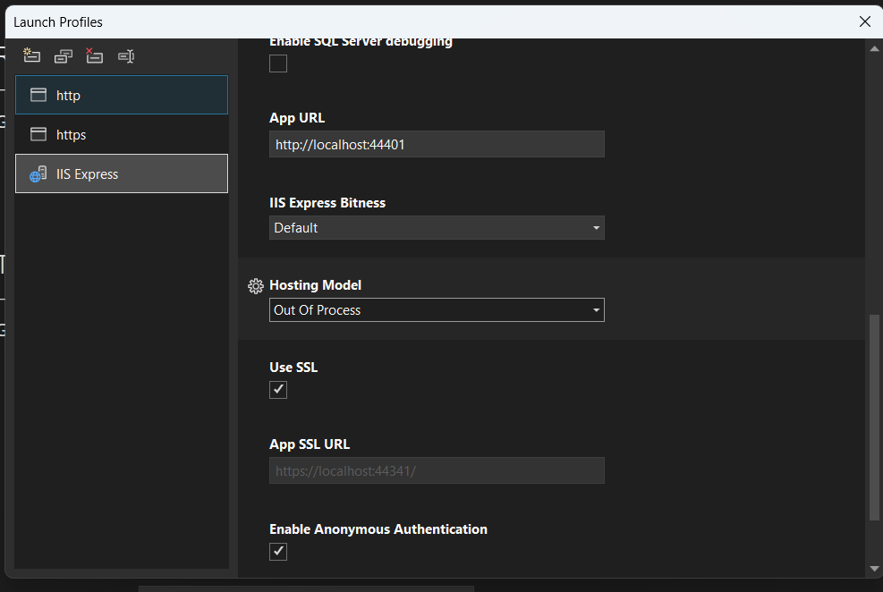
Introduction to .NET
ASP.NET Core Hosting Model
Configure OutOfProcess Hosting in ASP.NET Core

Slide 42
Introduction to .NET
ASP.NET Core Hosting Model
Configure OutOfProcess Hosting in ASP.NET Core
To use the OutOfProcess hosting model in Visual Studio, first, set the launch profile as http or https.
To display the process name in the browser, we need to modify the Main() method of the Program class as show below.
When the application is run from Visual Studio, the browser will display the message as show on the next slide.

Slide 43
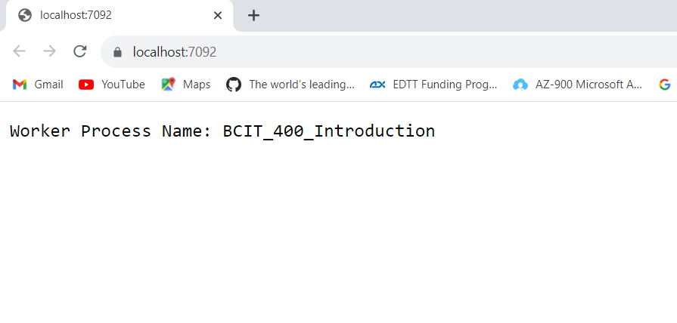
Introduction to .NET
ASP.NET Core Hosting Model
Configure OutOfProcess Hosting in ASP.NET Core

Slide 44
Introduction to .NET
ASP.NET Core Hosting Model
In Process | Out Of Process
Process name is w3wp.exe or iisexpress | Process name is the project name
Only one web server | Two web servers
Better for performance | Penalty of proxying requests between internal and external web servers

Slide 45
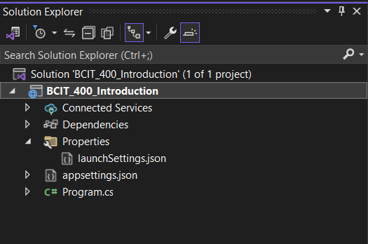
Introduction to .NET
ASP.NET Core LaunchSettings.json File
The settings within the LaunchSettings.json file will be used when we ASP.NET core application is launched or ran either from Visual Studio or by using .NET Core CLI.
This launchSettings.json file is only used within the local development machine.

Slide 46
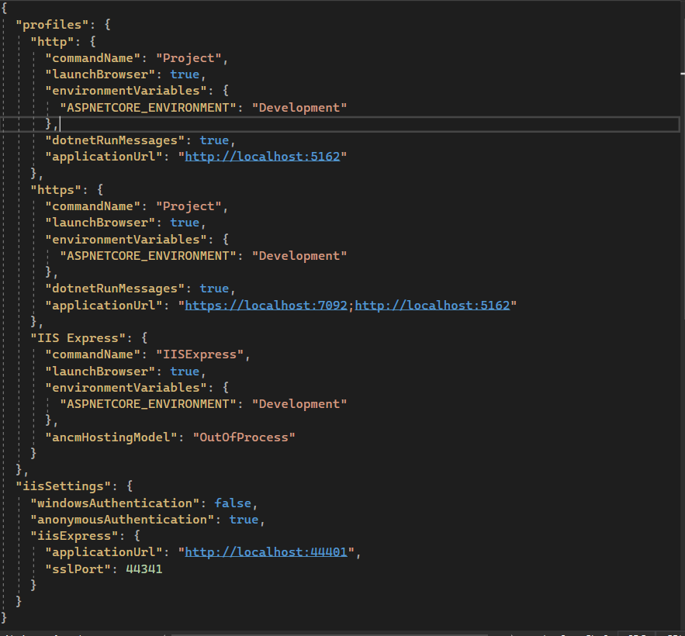
Introduction to .NET
ASP.NET Core LaunchSettings.json File
Opening the launchSettings.json file, then by default, the settings within that file in ASP.NET Core 7 (.NET 7) Applications is as below

Slide 47
Introduction to .NET
ASP.NET Core LaunchSettings.json File
Within the profiles there are 3 sections
http
https
IIS Express
CommandName: the value of the commandName property of the launchSettings.json file can be any one of the following
IISExpress
IIS
Project
The CommandName property value of the launchSettings.json file, along with the AspNetCoreHostingModel element value from the application’s project file, will determine the internal and external web server (reverse proxy server) that is going to use to host the application and handle the incoming HTTP Requests. See the table on the next slide.

Slide 48
BCIT-400 Introduction to .NET
ASP.NET Core LaunchSettings.json File
CommandName | Hosting Model | Internal Web Server | External Web Server
Project | Hosting setting ignored | Only one web server used | Kestrel
InProcess | InProcess | Only one web server used | IIS Express
IISExpress | OutOfProcess | Kestrel | IIS Express
IIS | InProcess | Only one web server used | IIS
IIS | OutOfProcess | Kestrel | IIS

Slide 49
Introduction to .NET
ASP.NET Core LaunchSettings.json File
launchBrowser: This property determines whether to launch the browser and open the root URL or not. The value true indicates that it will launch the browser, and the value false means it will launch the web browser once it hosts the application.
environmentVariables: This property allows us to declare configuration values. By default, it includes one configuration key called ASPNETCORE_ENVIRONMENT, using which the environment can be specified, such as Development, Production, and Staging.
applicationUrl: The applicationUrl property specifies the application base URL(s) using which the application can be accessed. If HTTPS is enabled while creating the project, then two URLs will be available, i.e., one URL using HTTP protocol and another URL using HTTPS protocol.
sslPort: This property specifies the HTTPS Port number using which the application can be accessed in the case of an IIS Express Server. The value 0 means you cannot access the application using HTTPS protocol.

Slide 50
Introduction to .NET
ASP.NET Core LaunchSettings.json File
windowsAuthentication: This property will specify whether Windows Authentication is enabled for the application or not. If true means Windows Authentication is enabled, and false means not enabled.
anonymousAuthentication: This property will specify whether Anonymous Authentication is enabled for the application or not. If true means Anonymous Authentication is enabled, and false means not enabled.
Running the ASP.NET Core Application using .NET Core CLI (i.e., dotnet run command), then the profile with the “commandName”: “Project” is going to be used.

Slide 51
Introduction to .NET
ASP.NET Core AppSettings.json file
In an ASP.NET Core Application; configuration settings such as database connection strings, any application scope global variables are stored in a configuration source
These configuration sources are
Files (appsettings.json, appsettings.{Environment}.json, where the {Environment} is nothing but the application’s current hosting environments such as Development, Staging, or Production)
User Secrets
Environment Variables
When an ASP.NET Core Web Application project is created with an Empty or Razor Pages or MVC or Web API Project Template, Visual Studio automatically creates the appsettings.json file for us, as shown in the image one the next slide.

Slide 52

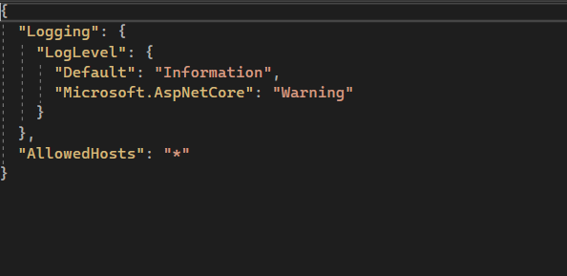
Introduction to .NET
ASP.NET Core AppSettings.json file
This file is used to store configuration settings such as connection strings, any application global variables etc
The appsettings.json file is a json file that stores value in the form of key-value pair.
Let us store the address of Cambrooks College in appsettings.json file
Opening the appsettings.json will display the image below

Slide 53
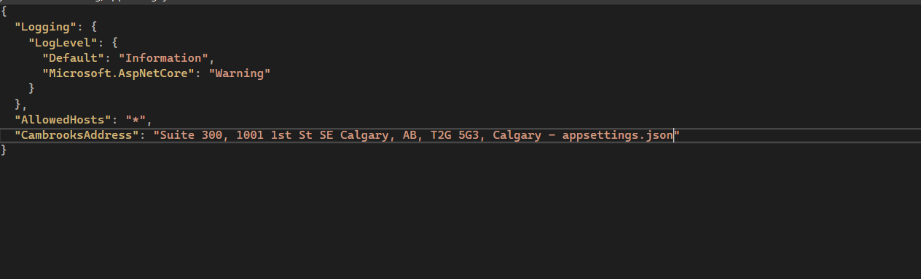
Introduction to .NET
ASP.NET Core AppSettings.json file
Modify the appsettings.json as shown below
To retrieve the value of the key CambrooksAddress in the Main() method, we use the IConfiguration service that is provided by the ASP.NET Core framework.
This service is set up in such a way that it knows how to read configuration information from the different configuration sources.

Slide 54
Introduction to .NET
ASP.NET Core AppSettings.json file
Calling the Configuration property using the builder object will return a ConfigurationManager instance.
ConfigurationManager configuration = builder.Configuration;
Configuration information in the appsettings.json file can be accessed from the ConfigurationManager instance in 2 ways
Using the GetValue Generic Method of the ConfigurationManager Class
Using the ConfigurationManager Class Indexer
Modify the Main() of the Program class to access the Configuration information as shown on the next slide

Slide 55
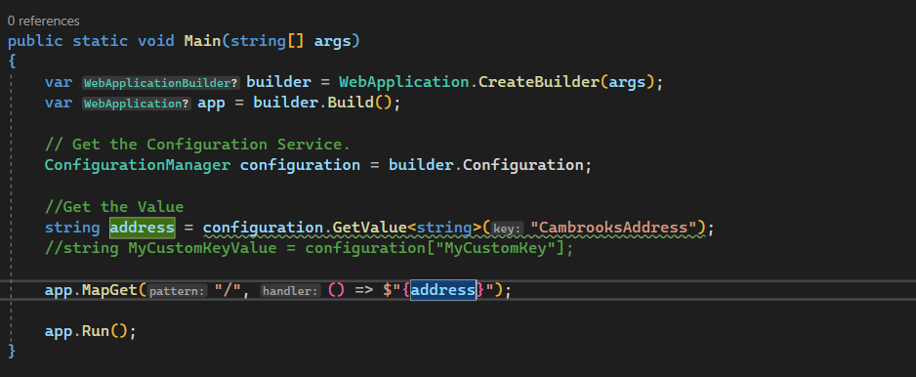
Introduction to .NET
ASP.NET Core AppSettings.json file
Run the application, the value as expected will be displayed in the browser as shown in the image on the next slide

Slide 56
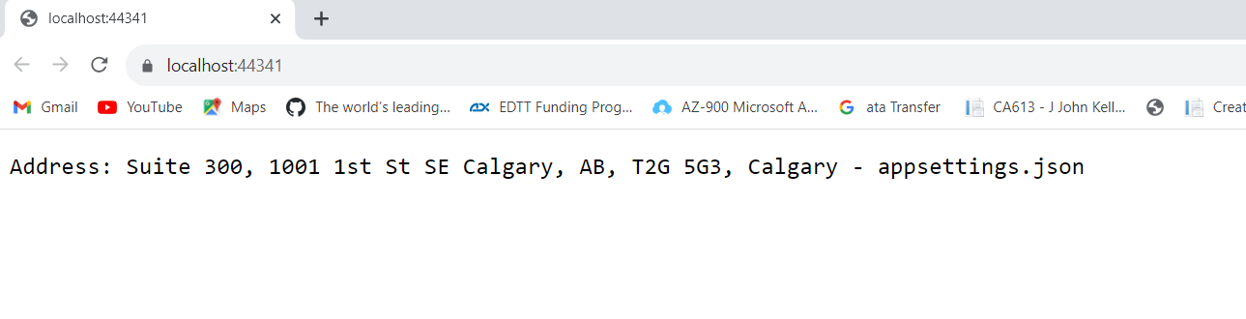
Introduction to .NET
ASP.NET Core AppSettings.json file
In the empty project template, there is another appsettings file called appsettings.Development.json.
Modify the file as shown in the image on the next slide

Slide 57
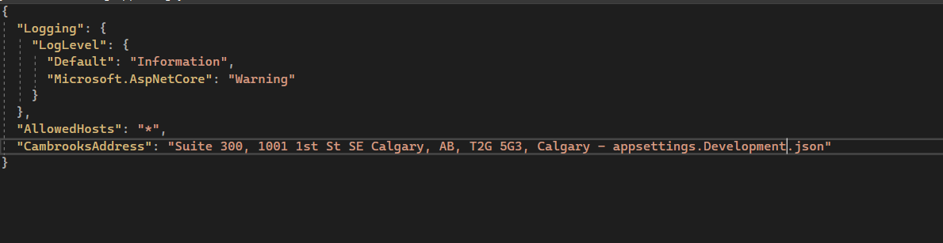
Introduction to .NET
ASP.NET Core AppSettings.json file
Run the application again, notice that the value of the information in the appsettings.Development.json is read first as shown in the image on the next slide.

Slide 58
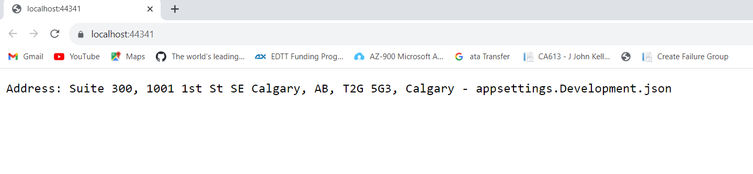
Introduction to .NET
ASP.NET Core AppSettings.json file
The default order in which information from the various configuration sources are read for the same key are as follows
appsettings.json
appsettings.{Environment}.json here we use appsettings.Development.json
User secrets
Environment Variables
Command-line arguments

Slide 59
Introduction to .NET
ASP.NET Core AppSettings.json file
We have read values in two places – appsettings.json and appsettings.Development.json
Now let us read value coming from the Envirnment Variable of the launchSettings.json in the IIS Express Profile Section of the launchSettings.json file as shown in the image on the next slide.
Remember to revert to hosting model back to InProcess

Slide 60
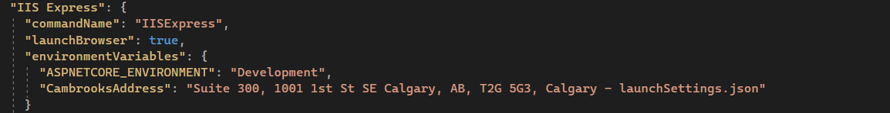
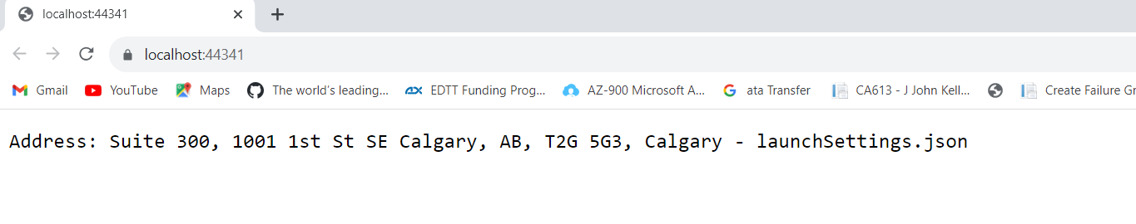
Introduction to .NET
ASP.NET Core AppSettings.json file
Run the application and the browser should display the information coming from the launchSettings.json as shown in the image below

Slide 61
Introduction to .NET
ASP.NET Core Middleware Components
The ASP.NET Core Middleware Components are the software components (Methods) that are configured into the Application Request Processing Pipeline to handle the HTTP Requests and Responses. Each middleware component in ASP.NET Core Application performs the following tasks.
Chooses whether to pass the HTTP Request to the next component in the pipeline. This is achieved by calling the next() method within the Middleware.
Can perform certain tasks before and after the next component is invoked in the pipeline.
Some of the in-built Middleware components in the ASP.NET core application are as below
UseAuthentication for authenticating the user.
UseHttpsRedirection for redirecting HTTP Requests to HTTPS.
UseHttpLogging is used to log the HTTP Requests and Responses.
UseDeveloperExceptionPage that is going to execute when there is an unhandled exception in the development environment.

Slide 62
Introduction to .NET
ASP.NET Core Middleware Components
UseExceptionHandler that is used to catch exceptions, log them, and re-execute the request in an alternate pipeline in a non development environment.
UseStaticFiles that is used to handle static files such as Images, Javascript. or CSS files, etc.
UseAuthorization that is used to Authorize the users while accessing a specific resource.
UseRouting adds the End Points Routing Middleware to the Request Processing Pipeline. If you want to define the Route using Pattern or attribute routing, then it is mandatory to use UseRouting Middleware Component.
Some of these Middleware components will be discussed as we progress through this course.
Middleware components are used to set up the Request Processing Pipeline in the ASP.NET Core Application.
The Request Processing Pipeline is the pipeline that will determine how the HTTP Requests and Responses are going to be processed in ASP.NET Core Application.
Middleware components are configured within the Main() method of the Program class, which is present inside the Program.cs class file.

Slide 63
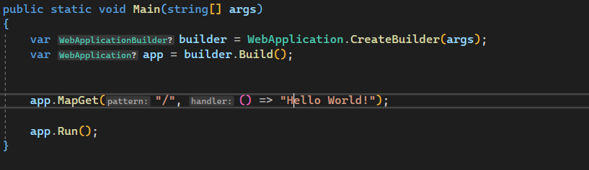
Introduction to .NET
ASP.NET Core Middleware Components
When a new ASP.NET Core project is created using the empty template; by default two middleware components are configured in the Main() method as shown in the image below
The MapGet and Run middleware components
Let us modify the Main() method as shown in the image on the next slide

Slide 64
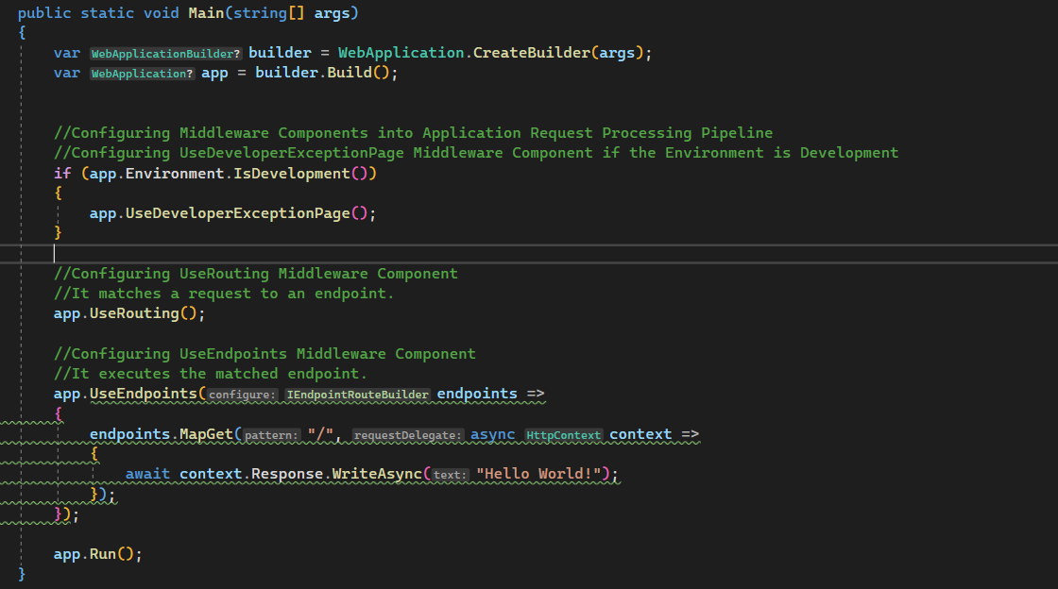
Introduction to .NET
ASP.NET Core Middleware Components

Slide 65
Introduction to .NET
ASP.NET Core Middleware Components
As you can see in the code from the last slide, the Main() method sets up the request processing pipeline with a few middleware components as follows.
UseDeveloperExceptionPage()
UseRouting()
UseEndpoints()
In the ASP.NET Core Web Application, the Middleware Component can have access to both the incoming HTTP Request and outgoing HTTP Response. So, a Middleware Component in ASP.NET Core Web Application can
Handle the incoming HTTP request by generating an HTTP response.
Process the incoming HTTP request, modify it, and then pass it to the Next Middleware Component that is configured in the Application Request Processing Pipeline.
Process the outgoing HTTP response, modify it, and then pass it on to either the previous middleware component or to the ASP.NET Core Web Server.

Slide 66
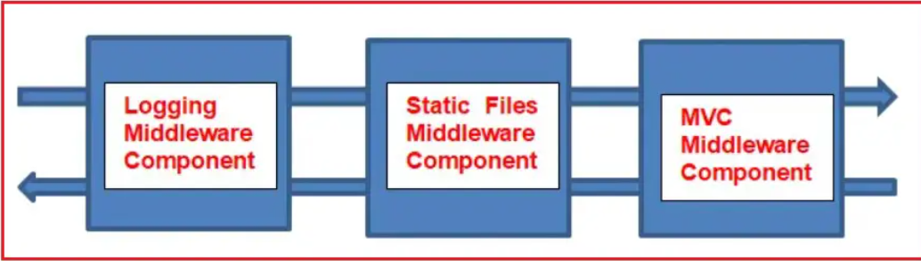
Introduction to .NET
ASP.NET Core Middleware Components
As shown in the below image, there are 3 Middleware Components configured in the Application Request Processing Pipeline to handle the HTTP Requests and Responses.
The Logging Middleware Component simply logs the request time and then passes the HTTP Request to the next middleware component, Static Files Middleware component in the Request Pipeline, for further processing

Slide 67
Introduction to .NET
ASP.NET Core Middleware Components
A Middleware Component in ASP.NET Core Web Application may handle the HTTP Request by generating an HTTP Response.
The Middleware Component may also decide not to call the Next Middleware Component in the Request Processing Pipeline.
This concept is called Short-Circuiting the Request Processing Pipeline.
In our example, if the incoming HTTP request comes for some static files such as Images, CSS files, JavaScript, etc., then this Static Files Middleware component can handle the request and then Short-Circuiting the Request Processing Pipeline by not calling to the Next Middleware Component in the pipeline, i.e., the MVC Middleware Component.
The logging middleware component, in our case, may log the time when the response is sent back to the client.
The ASP.NET Core Middleware Components are executed in the same order as they are added to the Request Processing Pipeline. So, proper care must be taken when adding the Middleware Components to the Request Processing Pipeline of the ASP.NET Core Web Application.

Slide 68
Introduction to .NET
ASP.NET Core Middleware Components
As per Application’s Business Requirements, any number of Middleware Components can be added into the Request Processing pipeline.
In ASP.NET Core, Request Delegates are used to build the Request Pipeline
Request Delegates are configured using the Run, Map, and Use Extension Methods.
Request Delegate can be specified using an in-line anonymous method (called in-line middleware) or using a reusable method.
These reusable methods and in-line anonymous methods are called Middleware or Middleware Components.
Each Middleware Component in the Request Processing Pipeline is responsible for invoking the Next Component in the Pipeline or Short-Circuiting the Pipeline by not calling the Next Middleware Component.

Slide 69
Introduction to .NET
ASP.NET Core Middleware Components
In ASP.NET Core Web Application, Extension Methods below are used to register the Inline Middleware Component into the Request Processing Pipeline.
Use - allows for adding middleware components, which may call the next Middleware Component in the Request Processing Pipeline.
Run - allows for adding the terminating middleware
Let us now look at the 3 Middleware Components we configured into our Request Processing Pipeline
UseDeveloperExceptionPage()
this middleware component will come into the picture only when the hosting environment is set to Development. This middleware component is going to execute when an unhandled exception occurs in the application, and since it is in Development mode, it is going to show the details of the exception on the webpage.

Slide 70
Introduction to .NET
ASP.NET Core Middleware Components
UseRouting()
The UseRouting() middleware component adds the Endpoint Routing Middleware to the request processing pipeline. Endpoint Routing means it will map the URL (or incoming HTTP Request) to a particular resource.
UseEndpoints()
To use UseEndpoints() Middleware Component. UseRouting() middleware component must be added first. In this UseEndpoints() Middleware Component, the routing decisions are going to be taken using the Map extension method. And as part of this UseEndpoints() Middleware Component, we can register multiple URL patterns using the MapGet or Map methods.
Instead of MapGet, the Map method can be used, as shown in the image on the next slide.

Slide 71
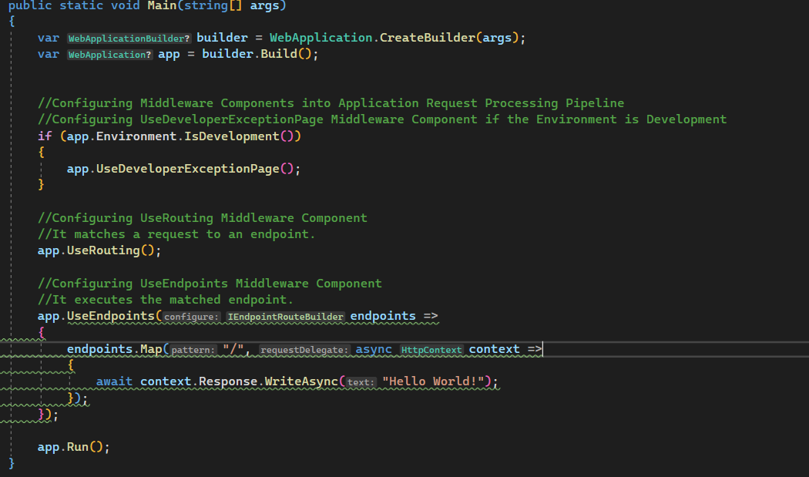
Introduction to .NET
ASP.NET Core Middleware Components
The MapGet Extension Method handles only the GET HTTP Requests, whereas the Map Extension Method is handles all types of HTTP requests, such as GET, POST, PUT, & DELETE, etc. in ASP.NET Core Web Application.

Slide 72
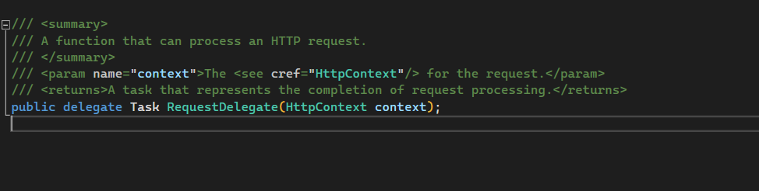
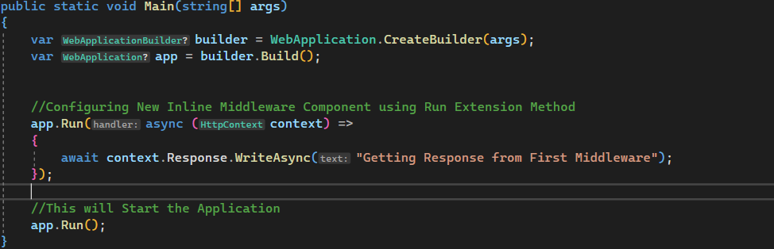
Introduction to .NET
ASP.NET Core Middleware Components
The RequestDelegate is a delegate that takes an input parameter of type HttpContext.
Let us modify the Main() method in the Program class as shown below, by passing the HTTP Context object as an input parameter to the request delegate as shown in the image below

Slide 73
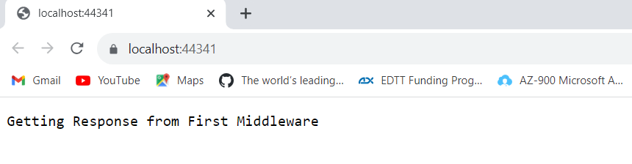
Introduction to .NET
ASP.NET Core Middleware Components
Run the application and the browser will display the image shown below
Now modify the Main() in the Program class by adding one more middleware component to the Application Request Processing Pipeline as show in the image on the next slide

Slide 74
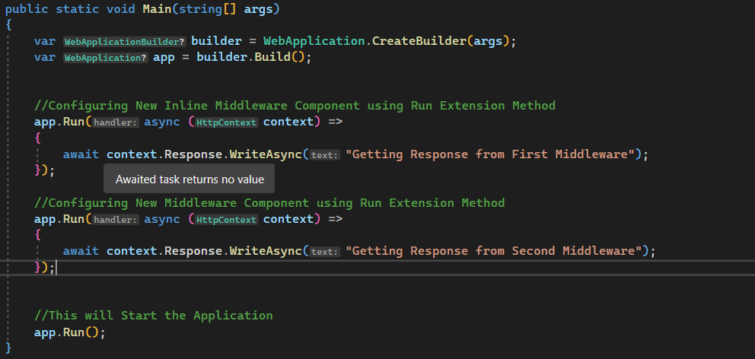
Introduction to .NET
ASP.NET Core Middleware Components
Run the application, you will notice that we don’t get the response from the second middleware component as shown in the image on the next slide

Slide 75
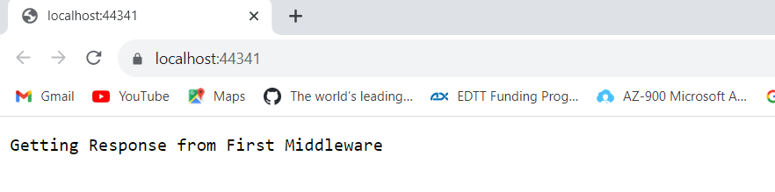
Introduction to .NET
ASP.NET Core Middleware Components
The reason is when a middleware component is registered using the Run() extension method, then that component becomes a terminal component means it will not call the next middleware component in the request processing pipeline.
To call the next middleware component we have to register it using the Use extension method as shown in the image on the next slide

Slide 76
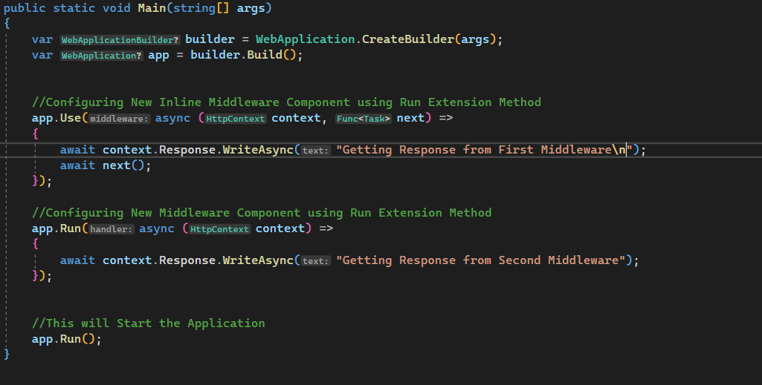
Introduction to .NET
ASP.NET Core Middleware Components
Run the application, the browser will display the output coming from both middleware components as shown in the image on the next slide

Slide 77
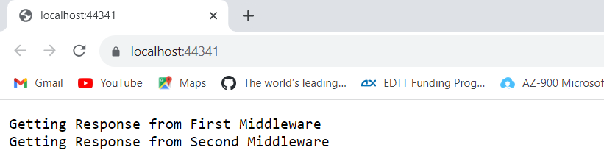
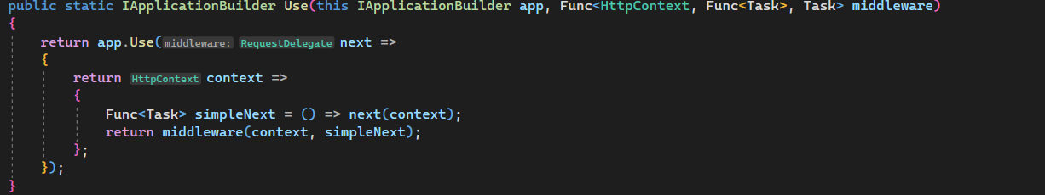
Introduction to .NET
ASP.NET Core Middleware Components
The Use extension method adds a middleware delegate defined in-line to the application’s request pipeline. Following is the definition of the Use extension method:

Slide 78
Introduction to .NET
ASP.NET Core Middleware Components
This method is also implemented as an extension method on the IApplicationBuilder interface
This is the reason why we are able to invoke this method using the IApplicationBuilder instance.
From the definition in the last slide, this method takes 2 input parameter
The first parameter is the HttpContext context object, through which it can access both the HTTP request and response.
The second parameter is the Func type, i.e., it is a generic delegate that can handle the request or call the next middleware component in the request pipeline.

Slide 79
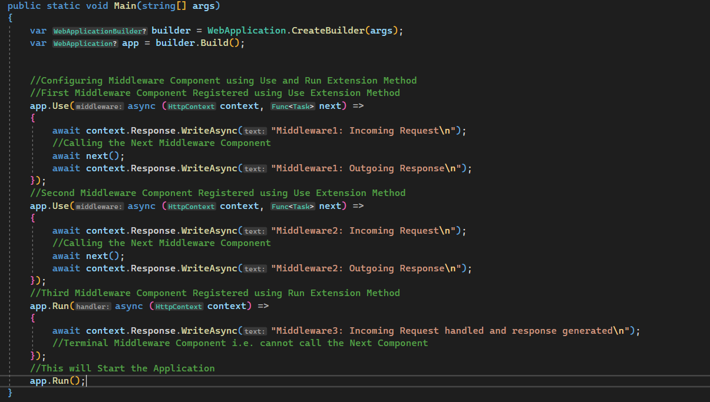
Introduction to .NET
ASP.NET Core Request Processing Pipeline
Let us modify the Main() method in the Program class as shown in the image below

Slide 80
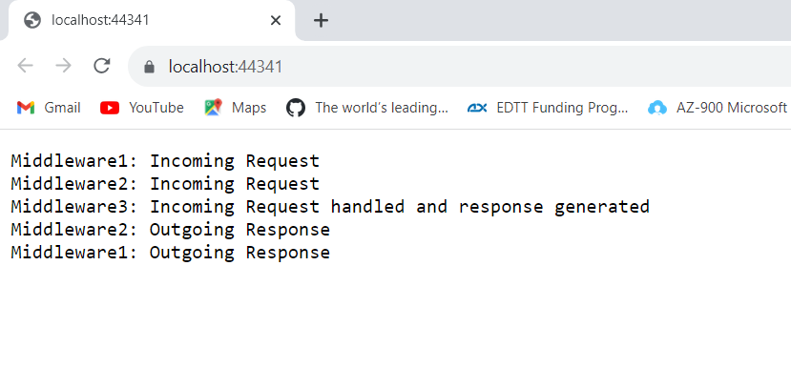
Introduction to .NET
ASP.NET Core Request Processing Pipeline
Run the application and the image below will be display on the browser
In order to understand the result displayed on the browser, let us compare the output displayed on the browser with the diagram on the next slide

Slide 81
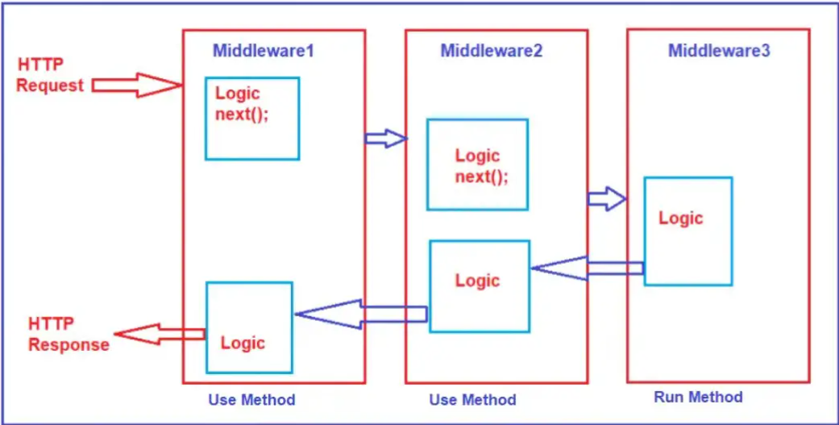
Introduction to .NET
ASP.NET Core Request Processing Pipeline

Slide 82
Introduction to .NET
ASP.NET Core Request Processing Pipeline
The first middleware component receives the incoming HTTP request, i.e., Middleware1, which logs “Middleware1: Incoming Request” in the response stream. So, as a result, we see this message first on the browser. Once the first middleware logs the information, it calls the next() method, invoking the second middleware in the request processing pipeline, i.e., Middleware2.
The second middleware logs the information “Middleware2: Incoming Request”. As a result, we see this log information after the first log. Then the second middleware calls the next(), invoking the third middleware in the request processing pipeline, Middleware3.
The third middleware handles the request and then produces the response. So, the third information that we see in the browser is “Middleware3: Incoming Request handled and response generated”.
Middleware3 component is registered using the Run() Extension Method and is a terminal component. So, from this point, the request pipeline starts to reverse, the control is given back to the second middleware, and the second middleware logs the information as “Middleware2: Outgoing Response” and then gives the control back to the first middleware component, and the first middleware component logs the information as “Middleware1: Outgoing Response” as what we see in the browser.

Slide 83
Introduction to .NET
wwwroot Folder in ASP.NET Core
By default, the wwwroot folder in the ASP.NET Core Web Application is treated as the webroot folder.
This folder or directory should be present in the project root directory.
In ASP.NET Core Web Application, the Static files can be stored in any folder under the webroot (wwwroot) folder and can be accessed with a relative path to that root.
When a new ASP.NET Core Web Application project with Web and MVC Template is created, by default, this folder (wwwroot) is created in the root project directory.
This folder is not included when the a new ASP.NET Core Application project is created with Empty Project Template
So let us add this folder to our project by right-clicking on the project and then select add => new folder option and then provide the folder name as wwwroot. Once created the folder is created, it should look like the image on the next slide

Slide 84
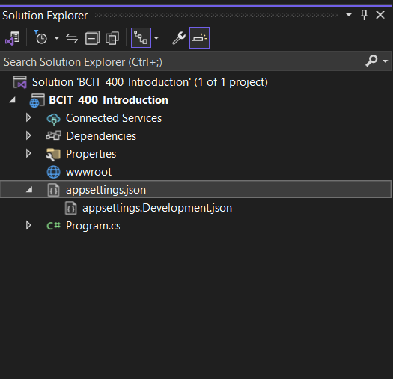
BCIT-400 Introduction to .NET
wwwroot Folder in ASP.NET Core
To serve static files in ASP.NET Core, add UseStaticFiles() Middleware component in the Application Processing Pipeline.
More on this in later session, but let us understand WebApplicationOptions Class in ASP.NET Core

Slide 85
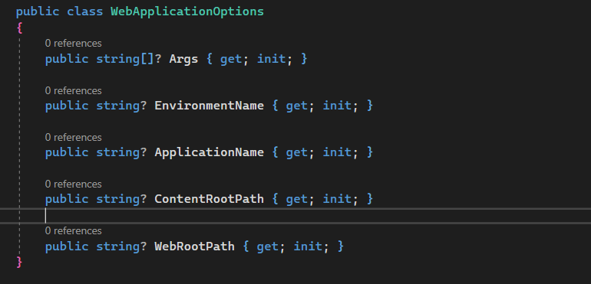
Introduction to .NET
wwwroot Folder in ASP.NET Core
WebApplicationOptions Class in ASP.NET Core
Using WebApplicationOptions Class, EnvironmentName, ApplicationName, WebRootPath, ContentRootPath, etc can be set.
The definition of the WebApplicationOptions class will show the image below

Slide 86
Introduction to .NET
wwwroot Folder in ASP.NET Core
WebApplicationOptions Class in ASP.NET Core
The meaning of the following properties
Args: The command line arguments.
EnvironmentName: The environment name.
ApplicationName: The application name.
ContentRootPath: The content root path – absolute path to the directory that contains the application content files.
WebRootPath: The webroot path - the directory’s absolute path containing the web-servable application content files.
Let us now modify the Main() method of the Program class as show in the image on the next slide

Slide 87
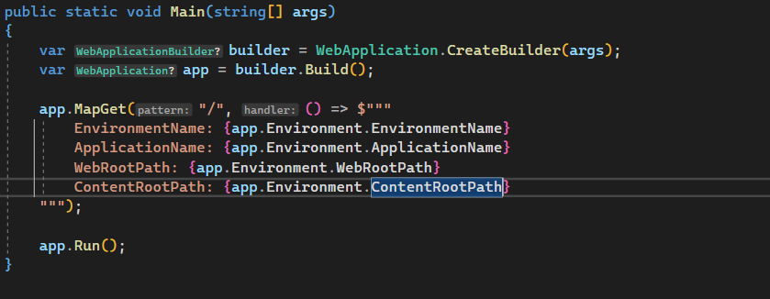
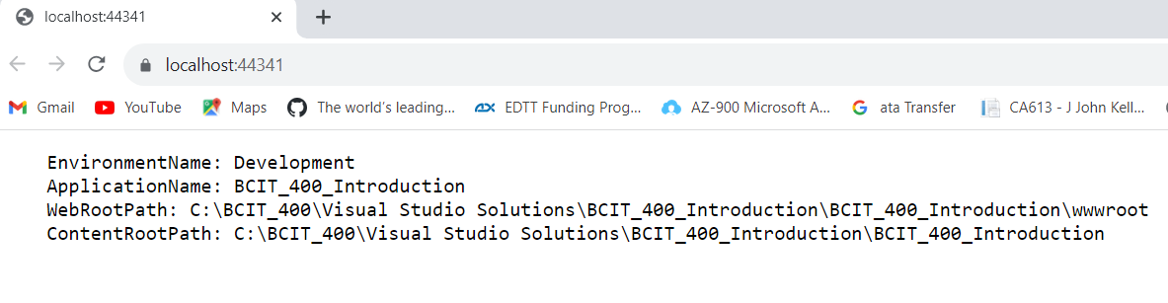
Introduction to .NET
wwwroot Folder in ASP.NET Core
WebApplicationOptions Class in ASP.NET Core
Run the application the information in the image below will be displayed on the browser

Slide 88
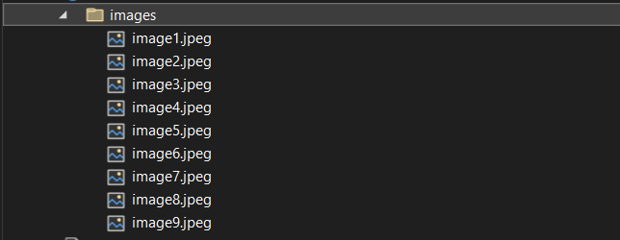
Introduction to .NET
Static Files Middleware in ASP.NET Core
In ASP.NET Core Application, the default directory or location for the static files is wwwroot (webroot) folder
This folder or directory should be present in the project root folder.
By default, this is the only place where the ASP.NET Core application can serve the static files directly
Let us add a folder called images to the wwwroot folder we created earlier as shown in the image below
Some images are added to the images folder as shown in the image below. I will have this images available when the course starts.

Slide 89

Introduction to .NET
Static Files Middleware in ASP.NET Core
Run the application and navigate to the URL,
https://localhost:<portnumber>/images/image1.png. My portnumber is 44341
The screen on the image below will be displayed by the browser

Slide 90
Introduction to .NET
Static Files Middleware in ASP.NET Core
To server static files, the ASP.NET Core application must meet 2 requirements
All static files must be present in the wwwroot folder (content root folder) and it must be in the root of the project
We have to register the static file Middleware in the Application’s Request Processing Pipeline
UseStaticFiles()
UseStaticFiles() middleware is an inbuilt middleware component provided by ASP.NET Core Framework to handle the static files in an ASP.NET Core Web Application.
Let us Modify the Main() Method of the Program class as shown below in order to add the UseStaticFiles() Middleware Component to the Request Processing Pipeline of the application as shown in the image on the next slide.

Slide 91

BCIT-400 Introduction to .NET
Static Files Middleware in ASP.NET Core
With the above modification in place, now run the application and navigate to https://localhost:<portnumber>/images/image.jpeg
The image on the next slide will be displayed by the browser

Slide 92

Introduction to .NET
Static Files Middleware in ASP.NET Core

Slide 93
Introduction to .NET
Default Page in ASP.NET Core
Most Web Applications have a default document that is served when users visit the root URL of an application.
For example you have a file named index.html and you want this file served when users visits the root URL i.e https://localhost:42331/
Let us add one HTML Page with the name index.html within the wwwroot folder.
To do so, right-click on the wwwroot folder and then select add => new item, which will open add new item window.
From the new item window, search for HTML and then select the HTML page, provide the HTML Page name as “index.html” and then click on the Add button as shown in the image on the next slide.

Slide 94

Introduction to .NET
Default Page in ASP.NET Core
On the index.html is added within the wwwroot folder, the project structure should look like the image on the next slide

Slide 95


Introduction to .NET
Default Page in ASP.NET Core
Modify the index.html file as shown in the image

Slide 96

BCIT-400 Introduction to .NET
Default Page in ASP.NET Core
Modify the Main() method in the Program class as shown in the image below
Now run the application and navigate to the URL: http://localhost:<portnumber>/index.html, and you will see the expected output coming from the static Index.html file, as shown in the image on the next slide.

Slide 97


Introduction to .NET
Default Page in ASP.NET Core
Remove the index.html from the URL or navigate to the base URL
The request is going to be handled by the terminating middleware, which is registered using the Run method as shown in the image below.

Slide 98

Introduction to .NET
Default Page in ASP.NET Core
This is not the behaviour we want. When we navigate to the base URL, we want index.html to serve the request.
To be able to serve the default page we have to add UseDefaultFiles() middleware component to the Application Processing Pipeline in the Main() method of the Program class as shown in the image below

Slide 99

Introduction to .NET
Default Page in ASP.NET Core
Default page can be any of the following
default.htm
default.html
index.htm
index.html
UseDefaultFiles() middleware must be called before UseStaticFiles() middleware to serve the default page
UseDefaultFiles() middleware is a URL rewriter. It does not actually serve the file, it simply rewrites the URL to the default document which will then be served by the UseStaticFiles() middleware.
Let us now run the application, and the image below will be displayed by the browser

Slide 100

Introduction to .NET
Default Page in ASP.NET Core
Can we use another html page as a default page. The answer is yes. To do this we would have to modify the Main() method of the Program class as shown below
Add a new html file called bcit.html to the wwwroot folder and modify it as shown in the image on the next slide

Slide 101


Introduction to .NET
Default Page in ASP.NET Core
Run the application and bcit.html should be served as the default page will be displayed by the browser as show on the image below.

Slide 102

Introduction to .NET
Default Page in ASP.NET Core
UseFileServer() Middleware
UseFileServer() middleware combines the functionality of UseStaticFiles(), UseDefaultFiles(), and UseDirectoryBrowser() middleware
UseDirectoryBrowser() middleware enables directory browsing and allows users to see files within a specified directory.
Let us now replace UseStaticFiles() and UseDefaultFiles() middlewares with UseFileServer() in the Main() method of the Program class as shown in the image below

Slide 103

BCIT-400 Introduction to .NET
Default Page in ASP.NET Core
UseFileServer() Middleware
Run the application and image below should be displayed on the browser should

Slide 104

BCIT-400 Introduction to .NET
Default Page in ASP.NET Core
UseDirectoryBrowser() Middleware
Let us add UseDirectoryBrowser() middleware to the Application Processing Pipeline in the Main() method of the Program class as shown in the image below
Run the application and browser should display the image on the next slide

Slide 105

Introduction to .NET
Default Page in ASP.NET Core
UseDirectoryBrowser() Middleware
This is the directory structure of the wwwroot folder, as shown in the image above

Slide 106

Introduction to .NET
Developer Exception Page Middleware in ASP.NET Core
Let us modify the modify the Main() method of the Program as shown in the image below
Run the application and the image on the next slide should be display by the browser

Slide 107

Introduction to .NET
Developer Exception Page Middleware in ASP.NET Core
The image above is the developer exception on the page
This is possible because the ASP.NET Core Framework automatically enables the developer exception page for the Development environment
Modify the Main() method of the Program class by adding the Developer Exception Page Middleware component as shown in the image on the next slide

Slide 108

Introduction to .NET
Developer Exception Page Middleware in ASP.NET Core
Run the application again, the browser will display the same exception page
The Developer Exception Page contains five tabs: Stack, Queue, Cookies, Headers, and Routing
Stack: This tab gives the information of stack trace, which indicates where exactly the exception occurred, the file name, and the line number that caused the exception.

Slide 109
Introduction to .NET
Developer Exception Page Middleware in ASP.NET Core
Stack: This tab gives the information of stack trace, which indicates where exactly the exception occurred, the file name, and the line number that caused the exception.
Query: This tab gives information about the query strings.
Cookies: This tab displays the information about the cookies set by the request.
Header: This tab gives information about the headers which is sent by the client when request was made.
Routing: This tab gives information about the Route Pattern and Route HTTP Verb type of the method, etc.
Only enable the Developer Exception Page Middleware only when the application is running in the Development Environment
UseDeveloperExceptionPage() Middleware should be configured as early as possible in the Application Processing Pipeline
So it can handle the unhandled exception
And display the Developer Exception Page with detailed information about the exception

Slide 110
Introduction to .NET
Environment Variables
In most Software Development Organizations we have a minimum of at least these development environments
Development
Staging
Production
Development Environment : Developers typically use this environment for their day to day development work. They would want non-minified JavaScript and CSS files to be loaded on a development environment for ease of debugging. Similarly they want developer exception page if there is an unhandled exception so they can understand the root cause of the exception and fix it if required.
Staging Environment : Many organizations, try to keep their staging environment as identical as possible to the actual production environment. The primary reason for this environment is to identify any deployment related issues. Also, if you are developing a B2B (Business to Business) application, you may be interfacing with other service provider systems. Many organizations, usually setup their staging environment to interface with the service providers as well, for complete end to end testing. Typically troubleshooting and debugging are not done on a staging environment, so for better performance we want minified JavaScript and CSS files to be loaded. If there is an unhandled exception, display user friendly error page instead of the developer exception page. A user friendly error page will not contain any technical details.

Slide 111

Introduction to .NET
Environment Variables
Production Environment : The actual live environment, that we use for day to day business. Production environment should be configured for maximum security and performance. So load minified JavaScript and CSS files to improve the performance. For better security, display a User Friendly Error Page instead of the Developer Exception Page. The technical details on the Developer Exception Page does not make sense to the end user and they can be used by malicious user to break into your application.
The environment variable is usually set in our local machine in launchSettings.json file
This value can also be set in the operating system.
To set in a Windows 11 OS follow the steps below
Open Windows Control Panel
In the Control Panel window, type “environment” in the “Search Control Panel” text box on the top right corner

Slide 112

Introduction to .NET
Environment Variables
To set in a Windows 11 OS follow the steps below
Click on "Edit the system environment variables" link
In the "System Properties" window that pops up, click on "Environment Variables" button

Slide 113

Introduction to .NET
Environment Variables
To set in a Windows 11 OS follow the steps below
Open Windows Control Panel
In the Control Panel window, type “environment” in the “Search Control Panel” text box on the top right corner
Click on "Edit the system environment variables" link
In the "System Properties" window that pops up, click on "Environment Variables" button
On the "Environment Variables" window that pops up, click on "New" button under "System variables" section
In the "New System Variable" window that pops up, type
ASPNETCORE_ENVIRONMENT in "Variable name" text box
Development in "Variable value" text box

Slide 114
Introduction to .NET
Environment Variables
To set in a Windows 11 OS follow the steps below
Click "OK" to close all the pop up windows
On a staging or production environment we typically set this environment variable in the operating system.
We usually set this variable to one of the following values depending on the environment in which our application is hosted and running.
Development
Staging
Production
If ASPNETCORE_ENVIRONMENT varaiable is not set it defaults to Production. This is done on purpose for better security and performance
Using the following method of the IWebHostEnvironment service to identify the environment in which the application is running
IsDevelopment()
IsStaging()
IsProduction()

Slide 115
Introduction to .NET
Environment Variables
For custom environments like UAT (User Acceptance Testing) or QA (Quality Assurance) environments, we use
isEnvironment(“UAT”)

Slide 116
Introduction to .NET
Introduction to ASP.NET Core MVC Framework
What is MVC?
MVC consists of three fundamental parts - Model, View and Controller. It's an architectural design pattern for implementing User Interface Layer of an application. A typical real world application usually has the following layers.
User Interface Layer
Business Logic Layer or Domain Layer
Data Access layer
MVC design pattern is usually used for implementing the User Interface Layer of the application.
Let us take a look at the image on the next slide

Slide 117

Introduction to .NET
Introduction to ASP.NET Core MVC Framework
What is MVC?
To understand how MVC design pattern works; Let's say we want to retrieve a specific student details (i.e a student whose ID is 1) and display those details on a web page as shown in the image on the next slide.

Slide 118

Introduction to .NET
Introduction to ASP.NET Core MVC Framework
What is MVC?
A user will issue a request and the URL may look like something like this https://cambrookscollege.ca/student/details/2
Let us take a look at the image on the next slide

Slide 119

Introduction to .NET
Introduction to ASP.NET Core MVC Framework
What is MVC?

Slide 120
Introduction to .NET
Introduction to ASP.NET Core MVC Framework
What is MVC?
When this request arrives at the server, it is the Controller in the MVC design pattern that receives the request and handles it.
The controller creates the model. The model has the classes that describe the data.
In addition to the data itself, Model also contains the logic to retrieve data from the underlying data source such as a database.
In addition to creating the Model, the controller also selects a View and passes the Model object to that View.
The view is only responsible for presenting the model data.
It is the view, that generates the required HTML to present the model data i.e the student data provided to it by the Controller.
This HTML is then sent over the network to the user who made the request.

Slide 121
Introduction to .NET
Introduction to ASP.NET Core MVC Framework
Role of Model in MVC Design Pattern
The Model in an MVC application represents the state of the application and any business logic or operations it should perform.
Business logic should be encapsulated in the model, along with any implementation logic for persisting the state of the application.
Strongly-typed views typically use ViewModel types designed to contain the data to display on that view.
The controller creates and populates these ViewModel instances from the model.
The Model represents a set of classes used to describe the application’s validation, business, and data access logic.
For our class project the model will consist of a Student and StudentBusinessLogicLayer classes as shown in the image on the next slide

Slide 122


Introduction to .NET
Introduction to ASP.NET Core MVC Framework
Role of Model in MVC Design Pattern

Slide 123
Introduction to .NET
Introduction to ASP.NET Core MVC Framework
Role of Model in MVC Design Pattern
In our example on the last slide, Student class to hold the student data in memory.
The StudentBusinessLayer class is used to manage the student data, i.e., going to perform the CRUD operation, Validate the Student data, etc.

Slide 124
Introduction to .NET
Introduction to ASP.NET Core MVC Framework
Role of View in MVC Design Pattern
Views in MVC Application are responsible for presenting content through the user interface.
In ASP.NET Core MVC Application, we use the Razor View Engine to embed .NET code in HTML markup.
There should be minimal logic (you should not write any business logic, calculation logic, etc.) within views
Logic in Views if any should only be related to presenting the content.
To display Student data on a web page. The Student model carried the student data to the view as shown in the image on the next slide.

Slide 125

Introduction to .NET
Introduction to ASP.NET Core MVC Framework
Role of View in MVC Design Pattern

Slide 126
Introduction to .NET
Introduction to ASP.NET Core MVC Framework
Role of Controller in MVC Design Pattern
Controllers in MVC Design Pattern are the components that handle user interaction, work with the model, and ultimately select a view to render.
Controller is the component in an MVC application that is used to handle the incoming HTTP Request.
Based on the user action, the respective controller will work with the model
Then sends the response back to the user who initially made the request
Let’s say a user issues a request to the following URL https://localhost:41334/Student/Details/2
The request will be mapped to the Details action method of the Student Controller
We will discuss how request is mapped to the Student Controller’s Details action method is later session
Let’s take a look at the code snippet of the Student Controller in the image on the next slide

Slide 127

Introduction to .NET
Introduction to ASP.NET Core MVC Framework
Role of Controller in MVC Design Pattern

Slide 128
Introduction to .NET
Introduction to ASP.NET Core MVC Framework
Role of Controller in MVC Design Pattern
As you can see from the last slide, the Student Controller creates the Student object within the Details action method
Student object here is the Model
To retrieve the Student data from the database, the controller uses the StudentBusinessLogicLayer class.
Once the controller creates the Student model with the necessary student data, it passes the Student model to the Details view.
The Details view then generates the necessary HTML in order to present the Student data.
The generated HTML is sent to the client over the network who initially made the request.

Slide 129
Introduction to .NET
Introduction to ASP.NET Core MVC Framework
For this class we will building a Student Management System using the .NET 7 MVC Framework
In addition to the MVC design pattern we will be using the Repository pattern
We will have 3 entity classes for this project; namely
Course, with the following properties
CourseID
Title
Credit
Enrollments – Navigation Properties
Instructor – Instructor data will be retrieve from a WebAPI service

Slide 130
Introduction to .NET
Introduction to ASP.NET Core MVC Framework
Enrollment, with the following properties
ID
CourseID
StudentID
Grade
Course – Navigation Property
Student – Navigation Property
Student, with the following properties
ID
ImageFile
FirstName
LastName
Gender
EnrollmentDate
Enrollments – Navigation Property

Slide 131

Introduction to .NET
Introduction to ASP.NET Core MVC Framework
Let us now create a new MVC Web Application project
Open Visual Studio and the screen in the image below will be displayed
Click on the New Project and the image on the next screen will open

Slide 132


Introduction to .NET
Introduction to ASP.NET Core MVC Framework
Select the ASP.NET Core Web App (Model-View-Controller) template as shown below
Click on the next button and the image below will open, enter StudentManagementSystem.Web as the Project name and StudentManagement as the Solution name. Select a location where you want to store your project and then click the next button

Slide 133

Introduction to .NET
Introduction to ASP.NET Core MVC Framework
On the next screen as shown on the image below, select .NET 7.0 (Standard Term Support) as the Framework, select None for Authentication type check the boxes Configure for HTTPS and Do not use top-level statements and click on the Create button

Slide 134

Introduction to .NET
Introduction to ASP.NET Core MVC Framework
Run the application and the browser should display the image below

Slide 135

Introduction to .NET
Introduction to ASP.NET Core MVC Framework
Open the index.html file in Home subfolder of the View folder and modify as shown in the image below
Run the application and the browser will display the image on the next slide

Slide 136

Introduction to .NET
Introduction to ASP.NET Core MVC Framework

Slide 137

Introduction to .NET
Introduction to ASP.NET Core MVC Framework
We are going to add 3 class library projects to our project. The projects are as follows
StudentManagementSystem.Lib
StudentManagementSystem.Data
StudentManagementSystem.BLL
To add a project
Right-click on the solution folder
Select Add and select New project
Select Class Library project template as shown in the image below and click next
Enter StudentManagementSystem.Lib as the Proejct name and click next, and the screen on the image on the next slide will display

Slide 138

Introduction to .NET
Introduction to ASP.NET Core MVC Framework
Enter StudentManagementSystem.Lib as the Project name and click next, and the screen on the image on the next slide will display
Select .NET 7.0 (Standard Term Support) and click the Create button.
Repeat the same process to create the
StudentManagementSystem.Data
StudentManagementSystem.BLL
You Solution Explorer should look as the image on the next slide

Slide 139

Introduction to .NET
Introduction to ASP.NET Core MVC Framework
Delete the Class1 classes on the new created project.

Slide 140


Introduction to .NET
Introduction to ASP.NET Core MVC Framework
Right-click on the StudentManagementSystem.Lib project, and add a New folder. Call the folder Models
In the Models folder add the following enums Gender and Grade as shown in the images below
Also in the Models folder add the following classes, Enrollment, Course and student as shown in the image on the next slide

Slide 141



Introduction to .NET
Introduction to ASP.NET Core MVC Framework

Slide 142

Introduction to .NET
Introduction to ASP.NET Core MVC Framework
In the StudentManagementSystem.BLL add the following folders, Interfaces and Repositories
Right-click on the Dependencies folder of the StudentManagementSystem.BLL and select Add Project Reference and check StudentManagementSystem.Lib checkbox as shown in the image below and then click the Ok button
Add the folding interfaces to the Interfaces folders, IStudentRepository, IEnrollmentRepository and ICourseRepository as shown on the images on the next slide

Slide 143



BCIT-400 Introduction to .NET
Introduction to ASP.NET Core MVC Framework

Slide 144

Introduction to .NET
Introduction to ASP.NET Core MVC Framework
Now we are going to use in-memory data using Entity Framework Core. Will discuss in details Entity Framework Core when we use data from SQL DataBase
To use in-memory data we will install a Nuget Package (Microsoft.EntityFrameworkCore.InMemory)
Select Tools, Nuget Package Manager and Manage Nuget Packages Solutions… the screen below will open
Select the Browse tab and search for Microsoft.EntityFrameworkCore.InMemory
Select Microsoft.EntityFrameworkCore.InMemory and click on the Install button

Slide 145

Introduction to .NET
Introduction to ASP.NET Core MVC Framework
In the Data project create a folder Data and add a class called MemoryDbContext and add the following code in the class as shown in the image below
In the Main() method of the Program.cs class we will register the MemoryDbContext class in the dependency injection container as shown in the next slide

Slide 146

Introduction to .NET
Introduction to ASP.NET Core MVC Framework
Create the following class in the Repository folder, MockStudentRepository as show in the images on the next slide
This class will inherit from the IStudentRepository interface and add the codes as shown in the image on the next slide

Slide 147


Introduction to .NET
Introduction to ASP.NET Core MVC Framework

Slide 148


Introduction to .NET
Introduction to ASP.NET Core MVC Framework

Slide 149

Introduction to .NET
Introduction to ASP.NET Core MVC Framework

Slide 150

Introduction to .NET
Introduction to ASP.NET Core MVC Framework
In the StudentManagementSystem.Web project, right-click on the Controllers folder, select Add and select Controller. On the next screen select MVC , Controller and select MVC Controller with read/write actions as shown in the image below
The click on the Add button, enter StudentsController as the name on the next screen as shown in the image on the next slide

Slide 151

Introduction to .NET
Introduction to ASP.NET Core MVC Framework
Then click on the Add button, the screen in the image on the next slide will display
StudentsController derives from the Controller base class

Slide 152


Introduction to .NET
Introduction to ASP.NET Core MVC Framework
Right-click on the Dependencies folder of the StudentManagementSystem.Web project and select Add Project Reference
Check the checkboxes StudentManagementSystem.BLL and StudentManagementSystem.Lib as shown in the image below. Then click the okay button

Slide 153


Introduction to .NET
Introduction to ASP.NET Core MVC Framework
Modify the Index method of the StudentController as shown in the image below
Run the application and navigate to https//localhost:<portnumber>/Student/GetStudentDetails/2
The student data in JSON format will be display in the browser as shown in the image below

Slide 154
BCIT-400 Introduction to .NET
Introduction to ASP.NET Core MVC Framework
The implementation of the GetStudentDetails method of Student Controller is not loosely coupled
This is tightly coupled to the MockStudentRepository
So any changes to MockStudentRepository, means the codes in the Student Controller would have to change
Dependency injection design pattern can overcome this problem
When we added the Student Controller in a previous slide, the image below was rendered
All the public methods of a controller class are known as Action Methods, like the Index() in the image above
Action methods are created for a specific action or operation in the application

Slide 155

Introduction to .NET
Introduction to ASP.NET Core MVC Framework
All the related actions, like modify student data, delete student data should be created inside a particular controller.
Actions method can return several types. In our example we return JSON (JavaScript Object Notation) data.
When an HTTP Request is issued, it is a controller action method that gets call
Default structure is http:domain.com/ControllerName/ActionMethodName
Pass Parameters in Action Methods
Our GetStudentDetails method is as shown in the image below
Run the application and navigate to https//localhost:<portnumber>/Student/GetStudentDetails?id=2

Slide 156

Introduction to .NET
Introduction to ASP.NET Core MVC Framework
The browser will render the image shown below
In our example we passed the parameter as a query string parameter.
In our upcoming classes will discuss parameter mapping, default mapping, and many more.

Slide 157
Introduction to .NET
Introduction to ASP.NET Core MVC Framework
Dependency Injection in ASP.NET Core
As mentioned earlier, the GetStudentDetails method of Student Controller is tightly coupled to MockStudentRepository
Dependency injection design pattern can overcome this problem
Dependency Injection makes the application loosely coupled, flexible and easily testable
Let us modify the Student Controller to use dependency injection.
To do this we will program against the IStudentRepository and not the concreate implementation of the MockStudentRepository as shown in the image on the next slide

Slide 158

Introduction to .NET
Introduction to ASP.NET Core MVC Framework
In the image below, we have implemented dependency injection using the constructor
We have also added another Action method Index() that retrieves all Students

Slide 159
Introduction to .NET
Introduction to ASP.NET Core MVC Framework
Throughout our application we will be programming against the interface IStudentRepository
Instead of the StudentController creating a new instance of an implementation of IStudentRepository, we are injecting IStudentRepository instance into the StudentController using the constructor.
This is called constructor injection, as we are using the constructor to inject the dependency.
Notice, we are assigning the injected dependency to a read-only field. This is a good practice as it prevents accidentally assigning another value to it inside a method.
At this point, if we run the project we get the following error InvalidOperationException: Unable to resolve service for type 'StudentManagementSystem.BLL.Interfaces.IStudentRepository' while attempting to activate 'StudentManagementSystem.Web.Controllers.StudentController’.
This is because the ASP.NET dependency injection container does not know which object instance to provide if someone requests an object that implements IStudentRepository
IStudentRepository may have several implementations. At the moment in our project we only have one implementation and that is MockStudentRepository

Slide 160
Introduction to .NET
Introduction to ASP.NET Core MVC Framework
As the name implies, MockStudentRepository works with the in-memory employee mock data.
In later classes, we will discuss providing another implementation for IStudentRepository that retrieves student data from SQL Server database.
ASP.NET core provides the following 3 methods to register services with the dependency injection container. The method that we use determines the lifetime of the registered service.
AddSingleton() - As the name implies, AddSingleton() method creates a Singleton service. A Singleton service is created when it is first requested. This same instance is then used by all the subsequent requests. So in general, a Singleton service is created only one time per application and that single instance is used throughout the application life time.
AddTransient() - This method creates a Transient service. A new instance of a Transient service is created each time it is requested.
AddScoped() - This method creates a Scoped service. A new instance of a Scoped service is created once per request within the scope. For example, in a web application it creates 1 instance per each http request but uses the same instance in the other calls within that same web request.
Now let us register the MockStudentRepository class with the ASP.NET Core Dependency Injection container using the AddScoped() method. This is done in the Main() method of Programs class as shown on the next slide.

Slide 161

Introduction to .NET
Introduction to ASP.NET Core MVC Framework
Before doing this, add StudentManagementSystem.BLL and StudentManagementSystem.Lib as a dependencies to StudentManagementSystem.Web project
At this point run the application and you will notice that exception is gone.

Slide 162

Introduction to .NET
Introduction to ASP.NET Core MVC Framework
Views in ASP.NET Core
In Our GetStudentDetails() action method in the StudentController we are returning JSON data.
Let us now modify the 2 methods to return View() as shown in the image below
Run the application and the exception on the next page will be rendered on the browser

Slide 163

Introduction to .NET
Introduction to ASP.NET Core MVC Framework
Views in ASP.NET Core
Since we are returning a View from the action method that is named GetStudentDetails(), by default MVC looks for a view file with same name that has .cshtml extension in the following locations
/Views/Student/GetStudentDetails.cshtml
/Views/Shared/GetStudentDetails.cshtml
Before we create these folders let us understand Views in ASP.NET Core

Slide 164
Introduction to .NET
Introduction to ASP.NET Core MVC Framework
Views in ASP.NET Core
A view contains the logic to display the Model data provided to it by the Controller.
A view is an HTML template with embedded Razor markup.
A view file has .cshtml extension if the programming language is C#.
By default, MVC looks for view files in the Views folder
View files that belong to a specific controller are stored in a sub-folder in the Views folder and that sub-folder has the same name as the controller.
The view file has the same name as that of the controller action method with a .cshtml extension
Now let create our views for the Student Control.
Add a new folder called Student to the Views folder as shown on the next slide

Slide 165

Introduction to .NET
Introduction to ASP.NET Core MVC Framework
Views in ASP.NET Core
Right-click on the Student folder and select Add and then select View
On the next screen select Razor View – Empty and then hit the Add button, the screen on the next slide will open up

Slide 166

Introduction to .NET
Introduction to ASP.NET Core MVC Framework
Passing Data to View in ASP.NET Core
The are 3 ways to pass data from the controller to a view
Using ViewData
Using ViewBag
Using a strongly typed model object – strongly typed view
Modify the GetStudentDetails() method in the Student Controller to use the ViewData to pass data as shown in the image below
Modify the View files GetStudentDetails.cshtml as shown in the image on the next slide

Slide 167

Introduction to .NET
Introduction to ASP.NET Core MVC Framework
Passing Data to View in ASP.NET Core
Run the application and navigate to https://<localhost>/student/getstudentdetails/2
The browser should render the image on the next slide

Slide 168

Introduction to .NET
Introduction to ASP.NET Core MVC Framework
Passing Data to View in ASP.NET Core
ViewData is a dictionary of weakly typed objects.
To store and retrieve data from the ViewData dictionary we use string keys.
String data can be accessed from ViewData dictionary without the need to cast the data to string type.
If we are accessing any other type of data, we need to explicitly cast it to the type we are expecting.
We had to cast the Student object to Student Type before accessing First Name, Initial and last Name properties of the Student object.

Slide 169

Introduction to .NET
Introduction to ASP.NET Core MVC Framework
Passing Data to View in ASP.NET Core
On the other hand ViewBag uses dynamic properties instead of string keys
Now let us modify GetStudentDetails() method using ViewBag as shown in the image below
Now let us modify the GetStudentDetails.cshtml view as shown on the image on the next slide

Slide 170

Introduction to .NET
Introduction to ASP.NET Core MVC Framework
Passing Data to View in ASP.NET Core
Both ViewData and ViewBag can be used to pass data from a Controller to a View
ViewBag is a wrapper around ViewData
With ViewData we use string keys to store and retrieve data from the ViewData dictionary
ViewBag dynamic properties are resolved dynamically at runtime.
Using a strongly typed model object creates a strongly typed view.

Slide 171

Introduction to .NET
Introduction to ASP.NET Core MVC Framework
Passing Data to View in ASP.NET Core
Let us now modify the GetStudentDetails() method in the StudentController as shown in the image below
Let us also modify the GetStudentDetails.cshtml view as shown in the image on the next slide

Slide 172


Introduction to .NET
Introduction to ASP.NET Core MVC Framework
Passing Data to View in ASP.NET Core
We will use the strongly typed view to pass data from the controller to view in this course
Run the application and navigate to the image URL https://<localhost>/student/getstudentdetails/2 the browser will render the image shown below

Slide 173
Introduction to .NET
Introduction to ASP.NET Core MVC Framework
ViewModels in ASP.NET Core
A model object may not contain all the data a view needs
In this case we create a ViewModel
ViewModel in ASP.NET Core MVC is a model that contains more than one model data required for a particular view
Combining multiple model objects into a single view model object provides us with better optimization.
See the image on the next slide

Slide 174

Introduction to .NET
Introduction to ASP.NET Core MVC Framework
ViewModels in ASP.NET Core
In the GetStudentDetails method we used using Student model object to pass Student details and ViewData to pass PageTitle.
We can create a ViewModel with Student property and PageTitle string property and use the ViewModel to pass data from the controller to the view.
Create a folder call ViewModels in the StudentManagementSytem.BLL project

Slide 175


Introduction to .NET
Introduction to ASP.NET Core MVC Framework
ViewModels in ASP.NET Core
Add a class called StudentViewModel with properties as shown in the image below
Now let us modify the GetStudentDetails() method in the Student Controller

Slide 176

Introduction to .NET
Introduction to ASP.NET Core MVC Framework
ViewModels in ASP.NET Core
We will now use the StudentViewModel as the model for our View as shown in the image below

Slide 177

Introduction to .NET
Introduction to ASP.NET Core MVC Framework
List View in ASP.NET Core
If you remembered we modified our Student Controller to include an Index Action method as shown in the diagram below
Add a RazorView called Index in the Student subfolder of the Views folder
Add the code to the view as shown in the image on the next slide

Slide 178

Introduction to .NET
Introduction to ASP.NET Core MVC Framework
List View in ASP.NET Core

Slide 179

Introduction to .NET
Introduction to ASP.NET Core MVC Framework
List View in ASP.NET Core
Run the application and navigate to this URL https://<localhost>/student
The browser will render the list of students as shown in the image below
The styling does not look good at the moment. We will discuss styling with bootstrap in future classes.

Slide 180

Introduction to .NET
Introduction to ASP.NET Core MVC Framework
Layout View in ASP.NET Core
Most of the web applications in general have the following sections
Header
Footer
Navigation menu
View specific content

Slide 181
Introduction to .NET
Introduction to ASP.NET Core MVC Framework
Layout View in ASP.NET Core
Having a Layout View will prevent
Repeating all the HTML for these different sections in every view in our application.
With this duplicated HTML in every view, maintaining our application would be a night mare
we can define them in a layout view and then inherit that look and feel in all the views.
With layout views, maintaining the consistent look and feel across all the views becomes much easier, as we have only one layout file to modify , should there be any change
Just like a regular view a layout view is also a file on the file system with a .cshtml extension
Since a layout view is not specific to a controller, we usually place the layout view in a sub folder called "Shared" in the "Views" folder
By default, in ASP.NET Core MVC, the layout file is named _Layout.cshtml.
The leading underscore in the file name indicates that it not intended to be served directly by the browser.
In our project the layout view is in the Shared subfolder of the Views folder as shown in the image on the next slide

Slide 182


Introduction to .NET
Introduction to ASP.NET Core MVC Framework
Layout View in ASP.NET Core
Having a Layout View will prevent
Open the _Layout.cshtml file and notice that the standard html, head, title and body elements are in this layout file
Because of this we do not have to repeat all these HTML in every view
View specific title is retrieved using @ViewData[“Title”] expression as shown in the image below

Slide 183

Introduction to .NET
Introduction to ASP.NET Core MVC Framework
Layout View in ASP.NET Core
@RenderBody() in the _Layout.cshtml is the location where view specific content is injected
For example, if index.chtml view is rendered using this layout view, index.cshtml view content is injected at where we have @RenderBody() method call
Let us modify our GetStudentDetails.cshtml view to use the layout view as shown in the image below and set the titlt of the page
In a later session we will discuss setting the layout property in a central location, instead setting it in every view.

Slide 184

Introduction to .NET
Introduction to ASP.NET Core MVC Framework
Section in a Layout View
A layout page in ASP.NET Core MVC can also include a section
A section can be optional or mandatory
It provides a way to organize where certain page elements should be placed
Where to place custom JavaScript files in view
If the custom JavaScript files is needed by a few views, they can be place at the bottom of the view
If the custom script file is required by all the views then we could place it in the Layout page as shown below.

Slide 185

Introduction to .NET
Introduction to ASP.NET Core MVC Framework
Section in a Layout View
If you noticed @await RenderSectionAsync("Scripts", required: false) in the image on the last slide was place just before the closing <body> tag
This method takes 2 parameters; the first parameter is the name of the section, and the second parameter specifies if the section is required or optional. If require the value is set to true
If required is set to true and if a content view does not include the section, an exception will be thrown
There are 2 ways to mark a layout section as optional, the 2 ways are shown in the image below
Let us assume we need the custom JavaScript files only in the GetStudentDetails.cshtml view, then we could make use of a section as shown in the image on the next slide

Slide 186

Introduction to .NET
Introduction to ASP.NET Core MVC Framework
Section in a Layout View
Every view that intends to provide content for the section, must include a section with the same name.
We use @section directive to include the section and provide the content as shown in the image above
The content is then injected into at the layout view at the location where we have the @RenderSectionAsync() method call

Slide 187

Introduction to .NET
Introduction to ASP.NET Core MVC Framework
_ViewStart.cshtml in ASP.NET Core
Layout property is used to associate a view with a layout view
_ViewStart.cshtml file is a special file in ASP.NET Core
The code in this file is executed first before codes in individual view are executed
Instead of setting the Layout property in each individual view, we can move that code into the _ViewStart.cshtml file.
Open the _ViewStart.cshtml file and you will see the code in the file as shown in the image below
With this setting, the layout view is available for all pages to use. So let use remove the _Layout setting we had in the GetStudentDetails.cshtml view
If you want to use a layout file that is different from what is specified in _ViewStart.cshtml, you can do so by setting the Layout property in an individual view.

Slide 188

Introduction to .NET
Introduction to ASP.NET Core MVC Framework
_ViewStart.cshtml in ASP.NET Core
In an ASP.NET Core MVC application, we can have multiple layout views.
Let's say for example, we have the following 2 layout views in our application. _AdminLayout.cshtml
_NonAdminLayout.cshtml
The logic in _ViewStart.cshtml in the image below will select the layout view depending on the logged-in user role.

Slide 189

Introduction to .NET
Introduction to ASP.NET Core MVC Framework
_ViewImports.cshtml in ASP.NET Core
_ViewImports.cshtml file is usually placed in the Views folder
It is used to include the common namespaces so we do not have to include them in every view that needs those namespaces
Just like, _ViewStart file, _ViewImports file is also hierarchical.
Let us place another _ViewImport file in the Student subfolder of the Views folder as shown in the image below
The settings specified in the _ViewImports file in the Student sub-folder overwrites the settings specified in the _ViewImports file in the Views folder.

Slide 190

Introduction to .NET
Introduction to ASP.NET Core MVC Framework
Routing in ASP.NET Core
There are 2 routing techniques in ASP.NET Core MVC
Conventional Routing
Attribute Routing
When a request from the browser arrives at our application, it is the controller in the MVC design pattern, that handles the incoming http request and responds to the user action
The incoming request URL is mapped to a controller action method
This mapping is done by the routing rules defined in our application
For our application we are using the Conventional Routing as set up in the Application Processing Pipeline in the Main() method of the Program class as shown in the image below

Slide 191
Introduction to .NET
Introduction to ASP.NET Core MVC Framework
Routing in ASP.NET Core
The Conventional Routing as depicted on the last slide is using the default route template
The default route template "{controller=Home}/{action=Index}/{id?}" maps most URL's that have the following pattern – https://localhost1234/Student/GetStudentDetails/2
In the above example
The first URL path segment "/Student" is mapped to the “StudentController
Path Segment | Maps
/Student | StudentController class
/GetStudentDetails | GetStudentDetails(int id) action method
/1 | Id parameter of the GetStudentDetails(int id) action method

Slide 192
Introduction to .NET
Introduction to ASP.NET Core MVC Framework
Routing in ASP.NET Core
When MVC finds the word /Student in the first URL path segment, it appends the word Controller and looks for a class with name StudentController.
The second URL path segment "/GetStudentDetails" is mapped to the GetStudentDetails(int id) action method in the StudentController
The third path segment “2" is mapped to the id parameter of the GetStudentDetails(int id) action method
This is done by a process called model binding. We will discuss model binding in detail in our upcoming classes
Notice in the following default route template, we have a question mark after the id parameter
The question mark, makes the id parameter in the URL optional
This means both the following URLs will be mapped to the GetStudentDetails() action method of the Student Controller
/Employees/Details/1
/Employees/Details/

Slide 193
Introduction to .NET
Introduction to ASP.NET Core MVC Framework
Routing in ASP.NET Core
The value "Home" in {controller=Home} is the default value for the Controller
The value "Index" in {action=Index} is the default value for the action method
So with these values in place, if we navigate to the application root URL; https://localhost:1234, these default values will be used and the request will be mapped to Index() action of the HomeController
Also the following URL will be mapped to Index() action method of the HomeController
https://localhost:1234/Home
https://localhost/Home/Index

Slide 194
Introduction to .NET
Introduction to ASP.NET Core MVC Framework
Attribute Routing in ASP.NET Core
Defining the Routes using the [Route] attribute either at the controller or the action method level is known as Attribute Routing
Attribute Routing gives us more control over the URLs by defining routes directly at action methods, controllers, or our ASP.NET Core MVC Web Application
Attribute Routing provides a more declarative and intuitive way to define routes compared to traditional convention-based routing
Both conventional routing and attribute routing can be used in the same project
If both Routings are present, then .NET Core will override the conventional routes
Let us modify our IStudentRepository interface and the MockStudentRepository class by adding the codes as shown in the image on the next slide

Slide 195

Introduction to .NET
Introduction to ASP.NET Core MVC Framework
Attribute Routing in ASP.NET Core

Slide 196

Introduction to .NET
Introduction to ASP.NET Core MVC Framework
Attribute Routing in ASP.NET Core

Slide 197


Introduction to .NET
Introduction to ASP.NET Core MVC Framework
Attribute Routing in ASP.NET Core
Modify the StudentController class action methods as shown in the images below
Add the new action shown in the image on the next slide

Slide 198

Introduction to .NET
Introduction to ASP.NET Core MVC Framework
Attribute Routing in ASP.NET Core
In the images we have added attribute routing to the action methods
[Route("/Student")]
[Route("Student/All")]
[Route("Student/GetStudentDetails/{id}")]
[Route("Student/Courses/{studentID}")]
The above routing are similar to using the conventional routing

Slide 199
Introduction to .NET
Introduction to ASP.NET Core MVC Framework
Attribute Routing in ASP.NET Core
In some scenarios, Convention-Based routing is very difficult to support certain URL patterns
But those URL patterns can be easily achieved by using the Attribute Routing in ASP.NET Core MVC Application
Now let us modify our URL Pattern for the GetStudentCourses() action method to [Route("Student/{studentID}/Courses")]
This pattern is not possible for the Conventional-Based routing
But this is easily achievable by conventional routing
We can apply Multiple Route Attributes to a Single Action Method in ASP.NET Core MVC Application as depicted in the Index action method of the StudentController class
We can access the Index() method of the StudentController using these 2 URL
[Route("/Student")]
[Route("Student/All")]
As we already discussed, conventional-based routing can specify the route parameters as part of the route template

Slide 200
Introduction to .NET
Introduction to ASP.NET Core MVC Framework
Attribute Routing in ASP.NET Core
We can also define Route Attributes with parameters as you must have noticed in the 2 URLs below
[Route("Student/GetStudentDetails/{id}")]
[Route("Student/Courses/{studentID}")]
{id} and {studentID} are route parameters
We can also make a parameter optional in Attribute Routing like conventional-based routing
We define a URI parameter as optional by adding a question mark (?) to the route parameter as shown below
[Route("Student/GetStudentDetails/{id?}")]
With Attribute Routing in ASP.NET Core MVC Application, the Controller name and Action Method names do not play any role
Let us modify the Index() action method of the StudentController as shown in the image on the next slide

Slide 201

Introduction to .NET
Introduction to ASP.NET Core MVC Framework
Attribute Routing in ASP.NET Core
If an action method does not have Attribute Routing, the action method the Conventional Routing
In the ASP.NET Core MVC Web Application, it is also possible to apply the Route() Attribute at the Controller class as well as on individual action methods
If you want to make the attribute routing less repetitive, then you need to use the route attributes on the controller and individual action methods levels
Let us modify the StudentController as shown in the images on the next slide

Slide 202


Introduction to .NET
Introduction to ASP.NET Core MVC Framework
Attribute Routing in ASP.NET Core

Slide 203
Introduction to .NET
Introduction to ASP.NET Core MVC Framework
ASP.NET Core Attribute Routing using Tokens
In ASP.NET Core, attribute routing using tokens allows you to create dynamic and parameterized routes by using tokens in the route template
These tokens are replaced with actual values during URL generation and routing, making your routes more flexible and capable of handling various scenarios
The token are enclosed (i.e., controller and action) within a pair of square braces ([ ])
The tokens (i.e., [controller] and [action]) are then replaced with the values of the controller and action method name where the route is defined
Let us modify our StudentController to use Token Attribute Routing as shown in the image on the next slide

Slide 204


Introduction to .NET
Introduction to ASP.NET Core MVC Framework
ASP.NET Core Attribute Routing using Tokens

Slide 205
Introduction to .NET
Introduction to ASP.NET Core MVC Framework
ASP.NET Core Attribute Routing using Tokens
The token controller will be replaced with the actual controller name, and similarly, the token action will be replaced with the actual action method name
The main advantage of using tokens in ASP.NET Core Attribute Routing is that in the future, if you rename the controller name or the action method name, then you do not have to change the Route templates
You must have noticed our HomeController is decorated with 3 Route Attributes
[Route("/")]
[Route("Home")]
[Route("Home/Index")]
Using "/" in a Route Attributes makes the action method the default action method of the application.

Slide 206

Introduction to .NET
Introduction to ASP.NET Core MVC Framework
Bootstrap in ASP.NET Core Application
Creating ASP.NET Core using the MVC template comes with Bootstrap installed in the wwwroot folder
Bootstrap is in the lib subfolder of the wwwroot folder as shown in the image below
To use Bootstrap in our application, it has to be referenced in the head section of the layout view as shown in the image on the next slide
Read about BootStrap at www.getbootstrap.com

Slide 207

BCIT-400 Introduction to .NET
Introduction to ASP.NET Core MVC Framework
Bootstrap in ASP.NET Core Application
Now let us style the Index Student view with Bootstrap as shown in the image on the next slide

Slide 208

Introduction to .NET
Introduction to ASP.NET Core MVC Framework
Bootstrap in ASP.NET Core Application
The styling will produce the image on the next slide

Slide 209

Introduction to .NET
Introduction to ASP.NET Core MVC Framework
Bootstrap in ASP.NET Core Application
Notice that the bootstrap styling produced a nicer table. We will be using boostrap for the remaining of this course
Now let us style the GetStudentDetails view using Bootstrap as shown on the next page

Slide 210

Introduction to .NET
Introduction to ASP.NET Core MVC Framework
Bootstrap in ASP.NET Core Application
The bootstrap style above will render the image on the slide on the browser

Slide 211

Introduction to .NET
Introduction to ASP.NET Core MVC Framework
Bootstrap in ASP.NET Core Application

Slide 212
Introduction to .NET
Introduction to ASP.NET Core MVC Framework
Tag Helpers in ASP.NET Core Application
Tag Helpers in ASP.NET Core are the Server-Side Components
Used to perform defined transformations on HTML Elements
Processed on the server to create and render HTML elements in the Razor files
There are two types of Tag Helpers in ASP.NET Core MVC
Built-In Tag Helpers: They come in-built into the ASP.NET Core Framework and can perform common tasks like generating links, creating forms, loading assets, showing validation messages, etc.
Custom Tag Helper: That can be created by us to perform our desired transformation on an HTML element
For this course we will be using built-in Tag Helpers
To make the Built-in Tag Helpers available for all the views of our application, we need to import the tag helpers inside the _ViewImports.cshtml file, by using @addTagHelper directive as shown in the image on the next slide

Slide 213

Introduction to .NET
Introduction to ASP.NET Core MVC Framework
Tag Helpers in ASP.NET Core Application
The above image is from the _ViewImports.cshtml file
In the image we use @addTagHelper to import the TagHelpers
Microsft.AspNetCore.Mvc.TagHelpers is the assembly that contains all the built-in TagHelpers
Now let us demonstrate how to use TagHelpers to generate anchor links
In the list of student table let use TagHelpers to generate anchor links
The image is reproduced on the next slide

Slide 214

Introduction to .NET
Introduction to ASP.NET Core MVC Framework
Tag Helpers in ASP.NET Core Application
The image above is generate from the Index view of the StudentController
When we click on any of the link nothing happens

Slide 215

Introduction to .NET
Introduction to ASP.NET Core MVC Framework
Tag Helpers in ASP.NET Core Application
We want when we click on the view button we want redirect the user to GetStudentDetails view
And when we click on the cancel button on the GetStudentDetails view we want to redirect the user back to the Index view
Now let us modify the Index.cshtml as shown below
Now when run the application and navigate to Index.cshtml view of the StudentControl
View the page source, you will see the image displayed on the next slide

Slide 216




Introduction to .NET
Introduction to ASP.NET Core MVC Framework
Tag Helpers in ASP.NET Core Application
The images above shows the View anchor link of the 4 students
Clicking on any of these links will display the specific Student details
In this example we are not using TagHelpers to generate the anchor link
We are manually appending the strings to generate the correct href attribute value
Now let us use TagHelpers as shown in the image on the next slide

Slide 217

Introduction to .NET
Introduction to ASP.NET Core MVC Framework
Tag Helpers in ASP.NET Core Application
In the image above we used
asp-controller to specify the controller
asp-action to specify the action method
asp-route-{name of the route parameter} to specify the route parameter, the name of our route parameter is id
Now run the application and view the page source of the Index view notice that the href attribute values are the same as when we manually appended the strings
We are going to use TagHelpers to generate our anchor links for the remained of this course
I will use the TagHelper for the cancel button in the GetStudentDetails view of the Student Controller as shown on the image on the next slide.

Slide 218

Introduction to .NET
Introduction to ASP.NET Core MVC Framework
Tag Helpers in ASP.NET Core Application
Notice on the image above we did not pass the route parameter

Slide 219

Introduction to .NET
Introduction to ASP.NET Core MVC Framework
Tag Helpers in ASP.NET Core Application
Image Tag Helper
Most modern browsers cache the image of a web page when a user visits the web page
When the user visits the same web page again, browser serve the image from the cache instead of downloading the image from the server again
In most cases, this is not a problem as images do not change that frequently
From a performance standpoint, wouldn't it be great to download the image only if it has changed on the serve
Using image from the browser cache if the image has not changed otherwise download the image
Image Tag Helper can help achieve this, this added as shown below

Slide 220
Introduction to .NET
Introduction to ASP.NET Core MVC Framework
Tag Helpers in ASP.NET Core Application
Image Tag Helper
Based on the content of the image, a unique hash value is calculated and is appended to image URL as shown in the image below
This unique string prompts the browser to reload the image from the server and not from the browser cache
Each time the image on the server changes a new hash value is calculated and cached
If the image has not changed the hash isn't recalculated
Using this unique hash value, the browser keeps track of whether the image content on the server has change

Slide 221
Introduction to .NET
Introduction to ASP.NET Core MVC Framework
Tag Helpers in ASP.NET Core Application
Environment Tag Helper
We are using Bootstrap in our ASP.NET Core Application
For ease of debugging, on our local development machine (i.e on the Development Environment) we want the application to load non-minified bootstrap css file (bootstrap.css)
On Staging, Production or any other environment except Development environment we want the application to load minified bootstrap css file (bootstrap.min.css) from a CDN (Content Delivery Network) for better performance.
However, if the CDN is down or for some reason, our application is not able to reach the CDN, we want our application to fallback and load the minified bootstrap file (bootstrap.min.css) from our own application web server
To achieve this very easily using ASP.NET Core <environment> tag helper
As discussed earlier, we use ASPNETCORE_ENVIRONMENT variable to set the application environment
The application environment for our local machine is set in launchsettings.json file
For staging and production environment it is set in the operating system
Environment tag helper supports rendering different content depending on the application environment

Slide 222

Introduction to .NET
Introduction to ASP.NET Core MVC Framework
Tag Helpers in ASP.NET Core Application
Environment Tag Helper
The _Layout page is modified as shown in the image below
In the image above, the environment Tag Helper is set to Development using the include attribute
This means that in the Development environment we are using the non minified bootstrap
In the second environment Tag Helper we are using the exclude attribute with a value of Development
So what this means is any environment that is not Development use the minified bootstrap from a CDN
We can either use the exclude attribute this way or we can use the include attribute and comma separate list hosting environments

Slide 223
Introduction to .NET
Introduction to ASP.NET Core MVC Framework
Tag Helpers in ASP.NET Core Application
Environment Tag Helper
The integrity attribute on the <link> element is used for Subresource Integrity check
Subresource Integrity (SRI), is a security feature that allows a browser to check if the file being retrieved has been maliciously altered
When the browser downloads the file, it recalculates the hash and compares it against the "integrity" attribute hash value
If the hash values match, the browser allows the file to be downloaded otherwise it is blocked
If for some reason the CDN is down, we want the application to fallback to using the minified bootstrap file from the application server
The _Layout is modified to show the code in the environment Tag Helper when the application falls back to using the minified bootstrap file from the application server. This is shown in the image on the next slide

Slide 224

Introduction to .NET
Introduction to ASP.NET Core MVC Framework
Tag Helpers in ASP.NET Core Application
Environment Tag Helper
The asp-fallback-href attribute is used to specify the fallback source

Slide 225
Introduction to .NET
Introduction to ASP.NET Core MVC Framework
Tag Helpers in ASP.NET Core Application
Form Tag Helper
The following tag helpers are used to create a form in ASP.NET Core
Form Tag Helper
Label Tag Helper
Input Tag Helper
Select Tag Helper
Textarea Tag Helper
We also have validation tag helpers
Now let us add a CreateStudent action in our StudentController to demonstration the use of Form Tag Helpers in the Create Student Form

Slide 226

Introduction to .NET
Introduction to ASP.NET Core MVC Framework
Tag Helpers in ASP.NET Core Application
Form Tag Helper
Below is the CreateStudent action method in the StudentController
The Create Student form using the Form Tag Helpers as shown in the image on the next slide

Slide 227


Introduction to .NET
Introduction to ASP.NET Core MVC Framework
Tag Helpers in ASP.NET Core Application
Form Tag Helper
The image above will render the image shown on the next page in the browser

Slide 228

Introduction to .NET
Introduction to ASP.NET Core MVC Framework
Tag Helpers in ASP.NET Core Application
Form Tag Helper

Slide 229
Introduction to .NET
Introduction to ASP.NET Core MVC Framework
Tag Helpers in ASP.NET Core Application
Form Tag Helper
To create a form we use the <form> tag helper
<form method=“post" asp-controller="Student" asp-action="CreateStudent">
The asp-controller and asp-action tag helpers are used
These 2 tag helpers specify the controller and the action method to which the form data must be posted when the form is submitted
We want to issue a POST request when the form is submitted, so we have set the method attribute to post
The Input Tag Helper binds an HTML <input> element to a model expression in the razor view
The model for the CreateStudent.cshtml view is StudentViewModel
This is specified using the model directive @model StudentViewModel

Slide 230
Introduction to .NET
Introduction to ASP.NET Core MVC Framework
Tag Helpers in ASP.NET Core Application
Form Tag Helper
To capture the student data we used the following input tag helpers
<input asp-for="Student.FirstName" />
<input asp-for="Student.Initial" />
<input asp-for="Student.LastName" />
<input asp-for="Student.EnrollmentDate" />
We also used the select tag help to capture the student gender
<select asp-for="Student.Gender" asp- items="Html.GetEnumSelectList<Gender>()">
</select>

Slide 231
Introduction to .NET
Introduction to ASP.NET Core MVC Framework
Tag Helpers in ASP.NET Core Application
Form Tag Helper
To capture the student data we used the following input tag helpers
<input asp-for="Student.FirstName" />
The above code generates with an input element with id and name attributes
<input type="text" id="Student_FirstName" name="Student.FirstName">
Similarly the same input element will be generated for other input element
The name attribute is required and it is used to map the value of the input element to the corresponding property of the model class when the form is submitted
This is done by a process called model binding in ASP.NET Core
<label asp-for="Student.FirstName"></label>
The Label Tag Helper generates a label element with the for attribute
<label for="Student_FirstName">FirstName</label>
The label is linked to the input element, because both the label for attribute and the input element id attribute have the same value Student_FirstName

Slide 232

Introduction to .NET
Introduction to ASP.NET Core MVC Framework
Tag Helpers in ASP.NET Core Application
Form Tag Helper
To capture the student data we used the following input tag helpers
The Select Tag Helper generates a select element with its associated option elements as shown below below
The options for the Gender select element can be hard-coded like in the example above, or they can come from an enum or a database table
For our project we are using the enum.
Now let us modify the Create Student form to use Bootstrap styling as shown in the image on the next slide

Slide 233


Introduction to .NET
Introduction to ASP.NET Core MVC Framework
Tag Helpers in ASP.NET Core Application
Form Tag Helper
The image on the right is a continuation of the image on the left
The bootstrap styling in the image will render the image on the next slide in the browser

Slide 234

Introduction to .NET
Introduction to ASP.NET Core MVC Framework
Tag Helpers in ASP.NET Core Application
Form Tag Helper
Now let us modify the <header> element of the HTML document of the _Layout.cshtml as shown in the image on the next slide

Slide 235

Introduction to .NET
Introduction to ASP.NET Core MVC Framework
The <header> element HTML will render the image shown on the next slide

Slide 236
Introduction to .NET
Introduction to ASP.NET Core MVC Framework

Slide 237

Introduction to .NET
Introduction to ASP.NET Core MVC Framework
Model Binding in ASP.NET Core
Model binding maps data in an HTTP request to controller action method parameters
The action parameters may be simple types such as integers, strings, etc or complex types like Customer, Employee, Order etc.
Model binding takes the tedious task of mapping request data to action method parameters away from the developer
In the GetStudentDetails action method of the StudentController

Slide 238
Introduction to .NET
Introduction to ASP.NET Core MVC Framework
Model Binding in ASP.NET Core
When an HTTP request https://localhost:1234/Student/GetStudentDetails/1 arrives at the GetStudentDetails action method of the StudentController
The default route template “{controller=Home}/{action=Index}/{id?}” or the attribute routing [Route(“[action]/{id}”)] routes the request to GetStudentDetails(int id)
The id value 1 in the request URL is mapped to the id parameter of theGetStudentDetails(int id) action method
MVC will bind the data in the request to the action parameters by name
Notice that the default route template, the attribute routing template and GetStudentDetails parameter all have the parameter name as id

Slide 239
Introduction to .NET
Introduction to ASP.NET Core MVC Framework
Model Binding in ASP.NET Core
To bind the request data to the controller action method parameters, model binding looks for data in the HTTP request in the following places in the order specified below
Form values
Route values
Query strings

Slide 240


Introduction to .NET
Introduction to ASP.NET Core MVC Framework
Model Binding in ASP.NET Core
Model binding also works for complex data type like Student
When the form above is posted to the server, the values in the form are mapped to the StudentViewModel object parameter of the

Slide 241
Introduction to .NET
Introduction to ASP.NET Core MVC Framework
Model Binding in ASP.NET Core
Model binding also works for complex data type like Student
Model binding in asp.net core binds the posted form values to the properties of the StudentViewModel object that is passed as a parameter to the CreateStudent() action method.
The value in the input element that has the name attribute set to “FirstName” is mapped to the “FirstName” property of the StudentViewModel object
Similarly this is done for other properties
To create a new student data, we fill in the CreateStudent view form with the student data
When we click on the Create button, we issue a POST request to the server. So let us modify the StudentController by adding a CreateStudent() method that will handle the POST request as shown in the image on the next slide

Slide 242

Introduction to .NET
Introduction to ASP.NET Core MVC Framework
Implement the AddStudent() method of the MockStudentRepository class as shown in the image on the next slide

Slide 243


Introduction to .NET
Introduction to ASP.NET Core MVC Framework
Now run the application and click on the Add Student link, you will notice there is an exception as shown below

Slide 244

Introduction to .NET
Introduction to ASP.NET Core MVC Framework
The AmbiguosActionException is because the StudentController has 2 CreateStudent action methods, and MVC does not know which action method to use for HttpGet and HttpPost.
So let us modify the 2 CreateStudent() action methods as shown in the image below

Slide 245

Introduction to .NET
Introduction to ASP.NET Core MVC Framework
Now run the application and click on the Add Student link and fill out the form details with information in the image below
Click on the create button and the image on the next screen will be rendered on the browser

Slide 246

Introduction to .NET
Introduction to ASP.NET Core MVC Framework

Slide 247
Introduction to .NET
Introduction to ASP.NET Core MVC Framework
A new student was create with the following information
First Name: Jessica
Last Name: Johnson
ID: 5
Gender: Female
Enrollment Date: 1989-03-23

Slide 248

Introduction to .NET
Introduction to ASP.NET Core MVC Framework
Model Validation in ASP.NET Core
In our application we want First Name, Last Name and Enrollment Data fields to be mandatory
If the required values are not provided and the form is submitted (Create button is clicked) we want the validation error messages to be display as on the image above

Slide 249

Introduction to .NET
Introduction to ASP.NET Core MVC Framework
Model Validation in ASP.NET Core
To make these fields to be mandatory we apply the Required attributes on the CreateStudentViewModel as shown in the image below

Slide 250

Introduction to .NET
Introduction to ASP.NET Core MVC Framework
Model Validation in ASP.NET Core
In the action method that handles the POST request, we use ModelState.IsValid property to check if validation has failed or succeed
If validation has failed we return the same view so the user can provide the required data and resubmit the form
This as shown in the image below

Slide 251

Introduction to .NET
Introduction to ASP.NET Core MVC Framework
Model Validation in ASP.NET Core
To display validation errors use asp-validation-for and asp-validation-summary tag helpers.
asp-validation-for tag helper displays a validation message for a single property of our model class. asp-validation-summary tag helper displays a summary of validation errors
This is depicted in the image below
The value for asp-validation-summary tag helper can be any of the following
All
ModelOnly
None

Slide 252

Introduction to .NET
Introduction to ASP.NET Core MVC Framework
Model Validation in ASP.NET Core
By default the Required attribute on a property displays the validation error message “The {property name} is required”
This default error message can be changed by using the ErrorMessage property of the Required attribute as shown in the image below

Slide 253
Introduction to .NET
Introduction to ASP.NET Core MVC Framework
Model Validation in ASP.NET Core
By default the Required attribute on a property displays the validation error message “The {property name} is required”
This default error message can be changed by using the ErrorMessage property of the Required attribute as shown in the image below

Slide 254

Introduction to .NET
Introduction to ASP.NET Core MVC Framework
File Upload in ASP.NET Core MVC
To upload a file we will use the IFormFile interface that is in Microsoft.AspNetCore.Http namespace
Modify CreateStudentViewModel as shown below
We replaced the string ImageFile with the IFormFile Photo

Slide 255


Introduction to .NET
Introduction to ASP.NET Core MVC Framework
File Upload in ASP.NET Core MVC
In the Post Create action method of the Student Controller modify the code as shown below

Slide 256


Introduction to .NET
Introduction to ASP.NET Core MVC Framework
File Upload in ASP.NET Core MVC
Modify the Create View as shown in the image below

Slide 257

Introduction to .NET
Introduction to ASP.NET Core MVC Framework
Edit Student Data
In the MockStudentRepository Class implement the UpdateStudent() as shown in the image below
In the StudentController Edit action method, modify the code as shown in the image on the next slide

Slide 258

Introduction to .NET
Introduction to ASP.NET Core MVC Framework
Edit Student Data
This method is a GET request. The student data with the requested id is retrieved from the database and used to populate and instance of the EditStudentViewModel, because the View expects a model of the type EditStudentViewModel as shown on the next slide.

Slide 259


Introduction to .NET
Introduction to ASP.NET Core MVC Framework
Edit Student Data
In the Student Controller modify the Edit action method for the POST request as shown in the image on the next slide

Slide 260


Introduction to .NET
Introduction to ASP.NET Core MVC Framework
Edit Student Data

Slide 261

Introduction to .NET
Introduction to ASP.NET Core MVC Framework
Edit Student Data

Slide 262

Introduction to .NET
Introduction to ASP.NET Core MVC Framework
Delete Student Data
Deleting student data is very similar to editing the student data. We will discuss the details in class.
We will use this approach for deleting student data from the student list page
In the student details page we will us an inline delete approach as shown in the image below
When the delete button is clicked a confirmation dialog expands prompting the user to click the Yes button for delete.
When the No button is clicked the confirmation dialog collapses. We will be using JavaScript to achieve this.

Slide 263
Introduction to .NET
Introduction to ASP.NET Core MVC Framework
Using the procedure we will code the Create, Delete, Update, and Delete (CRUD) operations for Enrollment and Course Entities.

